Slide 1
Computer Vision in Construction Final Presentation
Identification of Hazardous Area(Dangerous Zone?) on Construction Site Based on Computer Vision ？
B07501113 林庭瑄、B07501046 陳蓮安、B07501106 彭永椿、D07521003 徐瑋澤、D10521039 杜雨晨

Slide 2
Outline
Introduction
Literature Review
Research purposes
Method & Result
Conclusion and Contribution
References

Slide 3
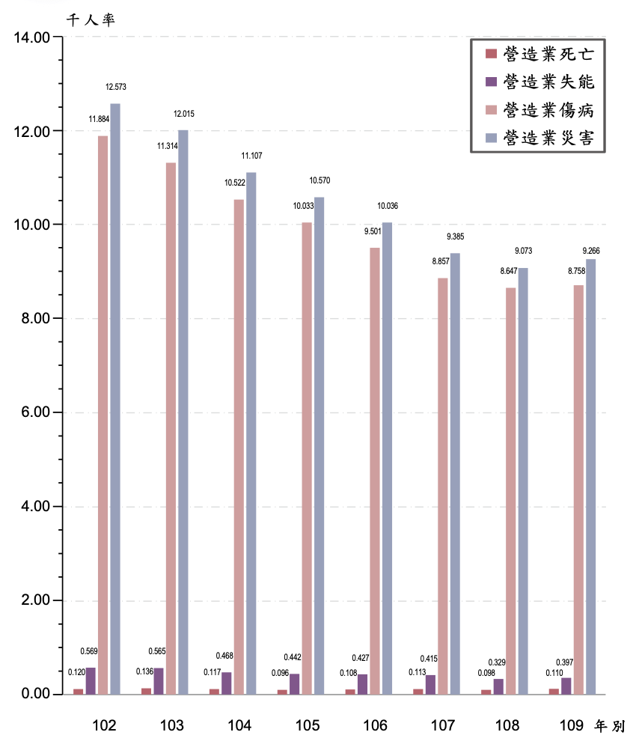
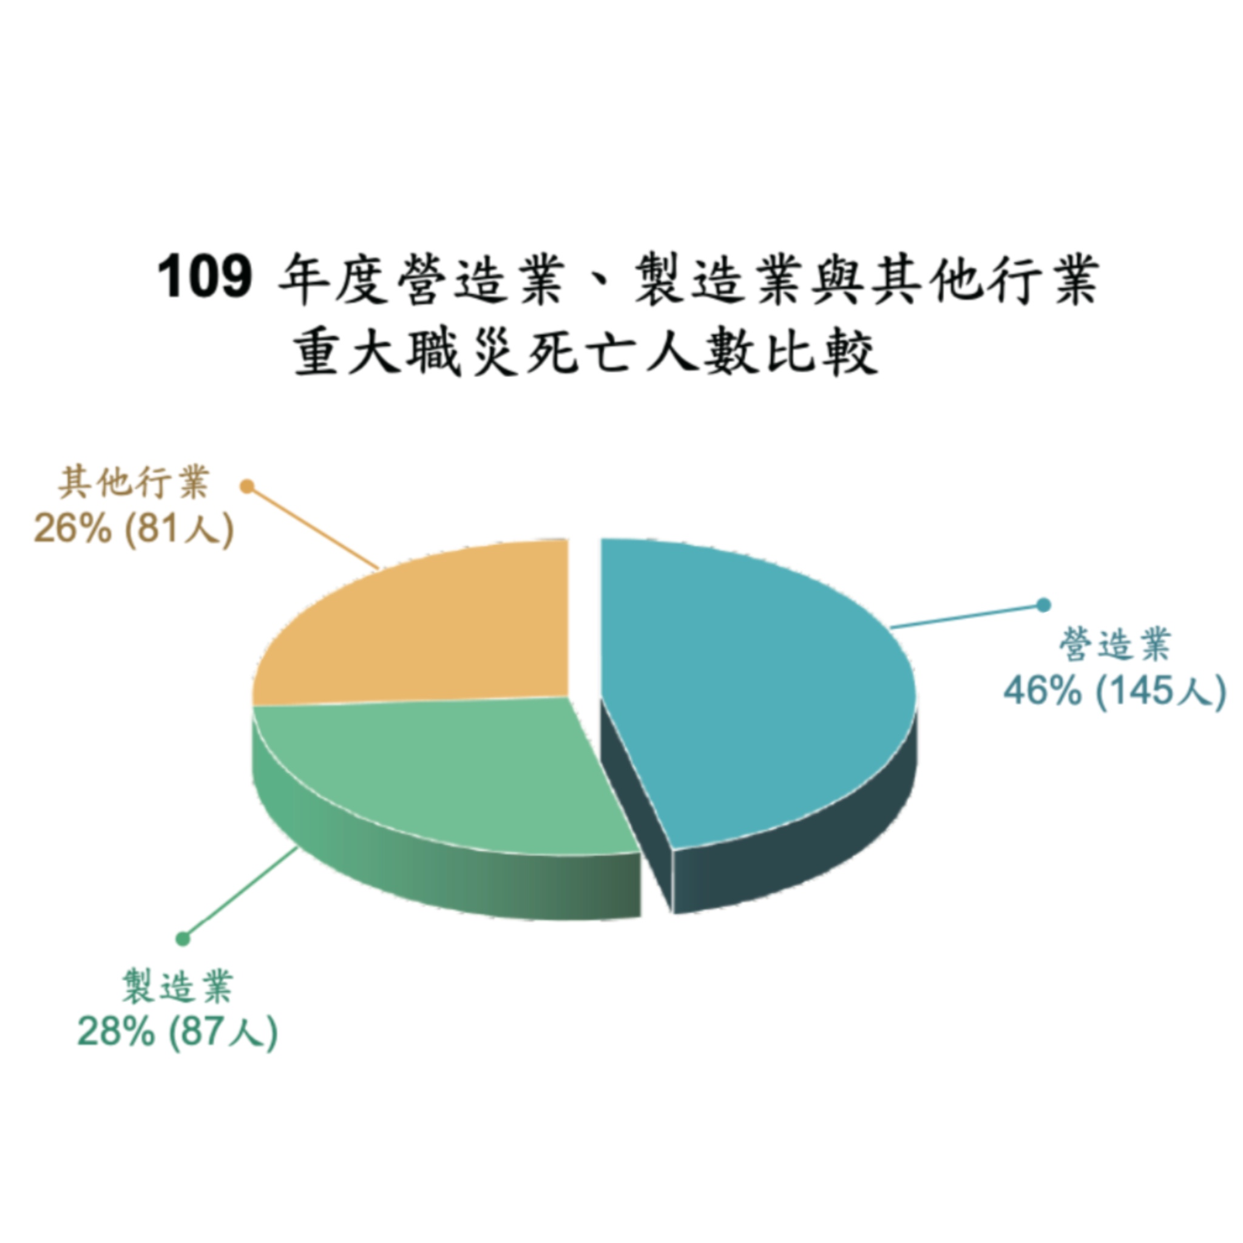
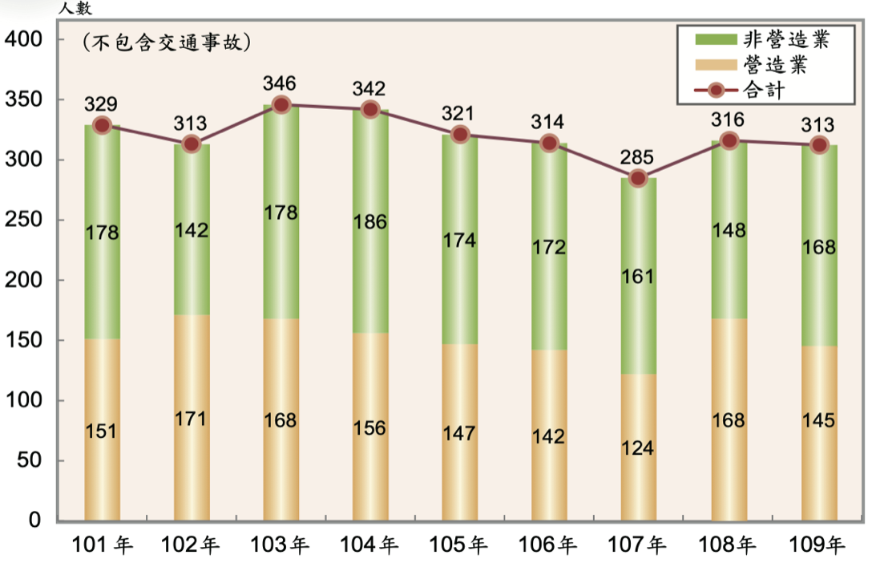
Introduction
Construction: a hazardous work
At least 108 thousand workers are killed on site every year, a figure which represents about 30 percent of all occupational fatal injuries.
（ILO，2015）
(OSHA , 2021)

Slide 4
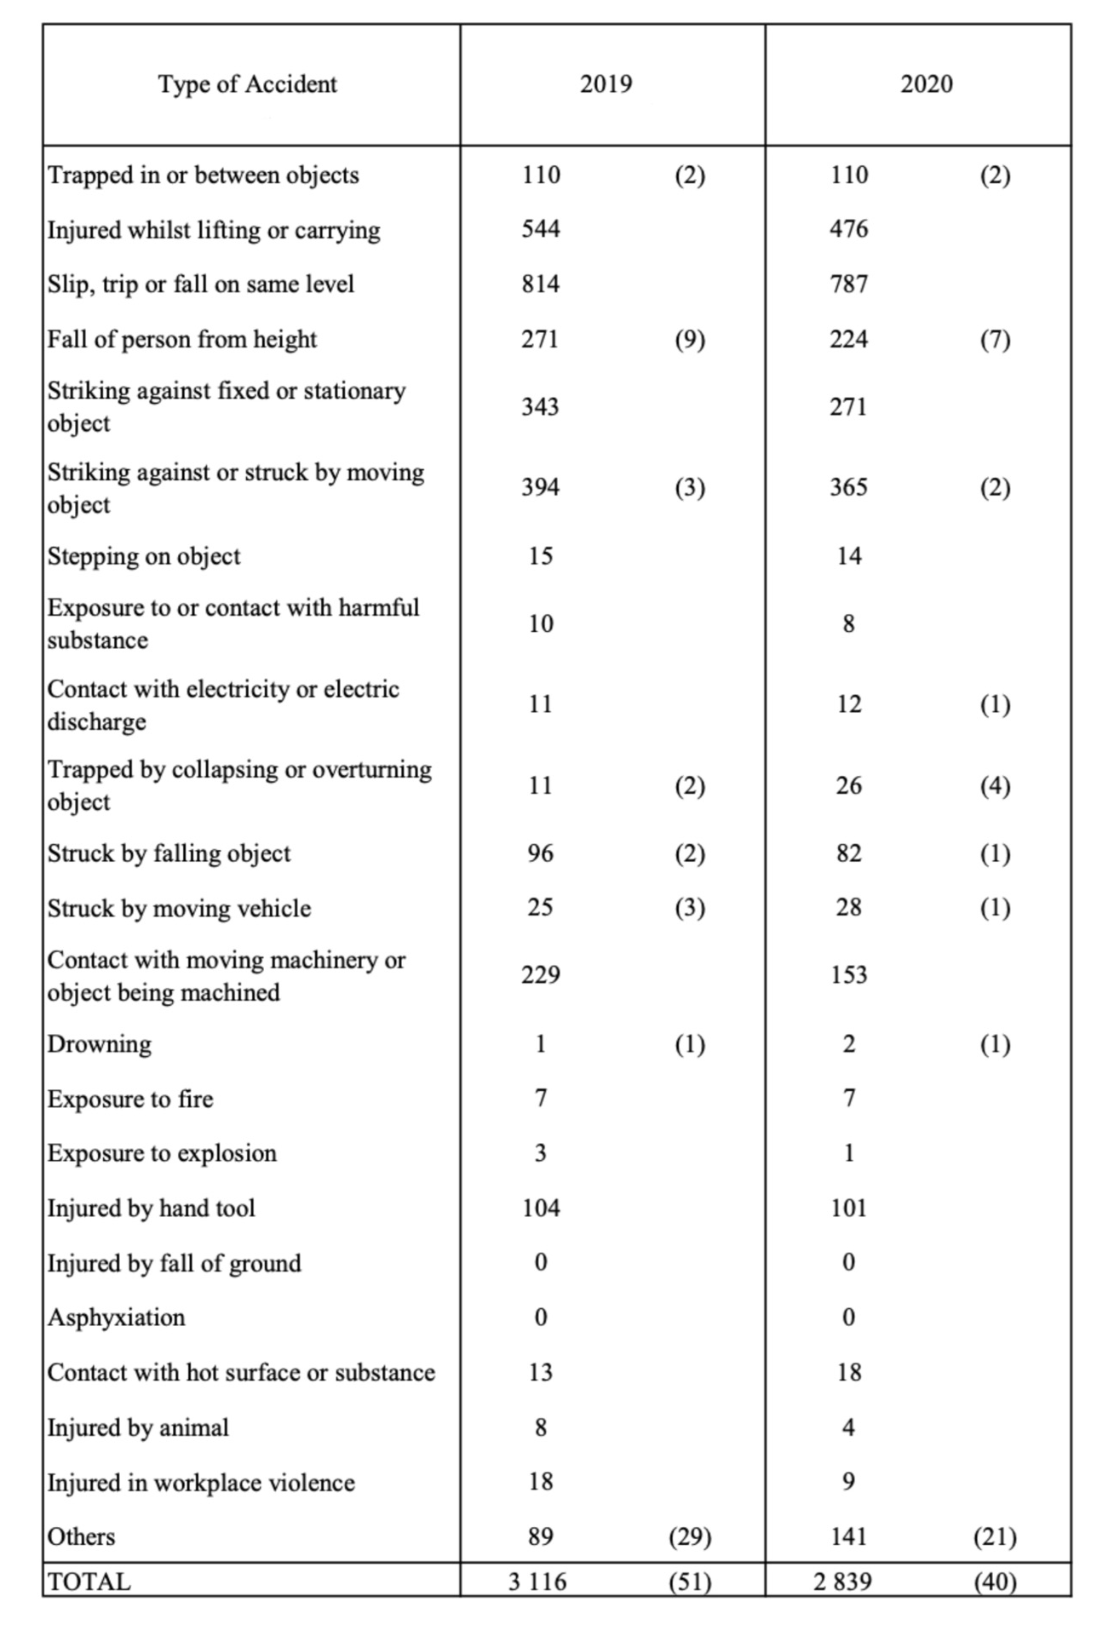
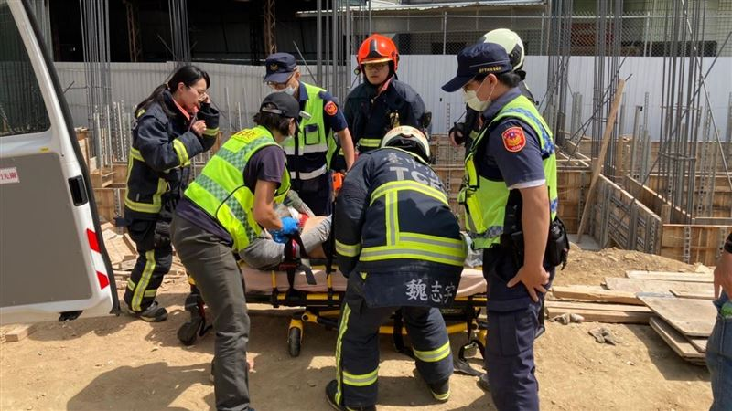
Introduction
Type of Accident :
fall、tumble、stab wound、incised wound、chafe…
(Labour Department, 2021)

Slide 5
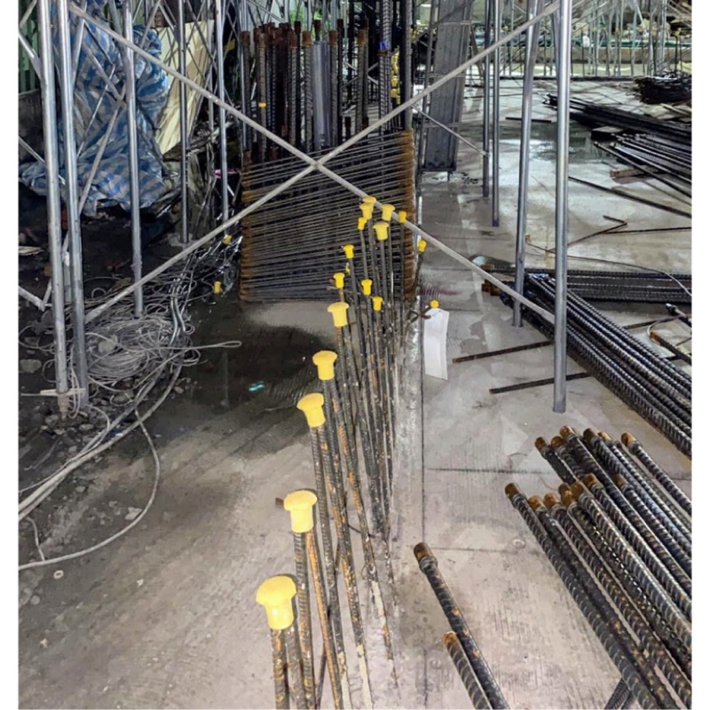
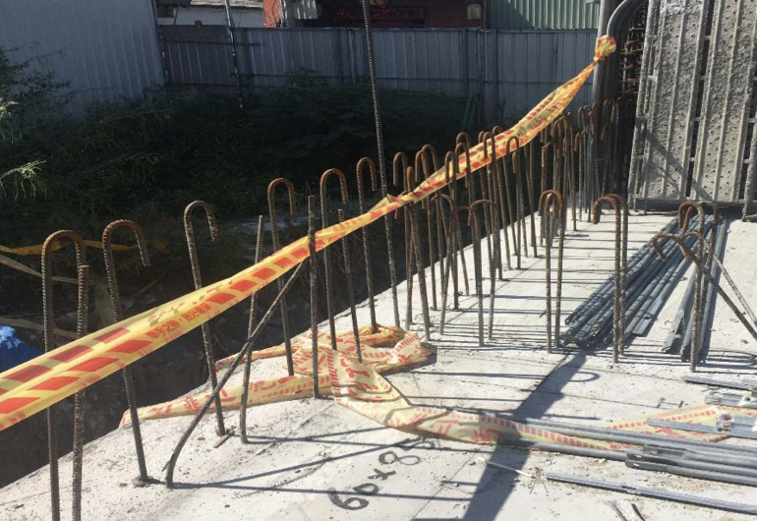
Introduction
Law
Employers should take protective measures such as bending tips, adding covers or adding sheaths for those exposed in the workplace, such as steel bars, steel, iron, aluminum and other materials that are prone to occupational hazards.
（Ministry of Labor , 2021）
Problem
Current construction hazard identification mostly relies on safety managers' capabilities to detect hazards. Consequently, numerous hazards remain unidentified, and unidentified hazards mean that hazards are not included in the safety management process.
（Kim et al , 2016）

Slide 6
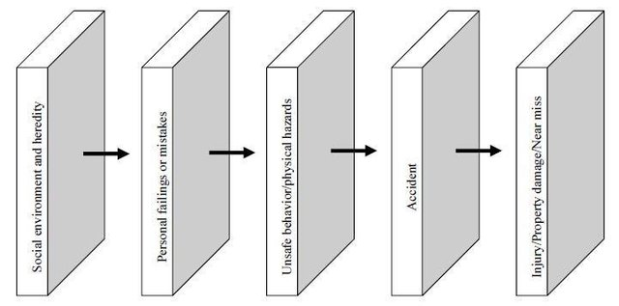
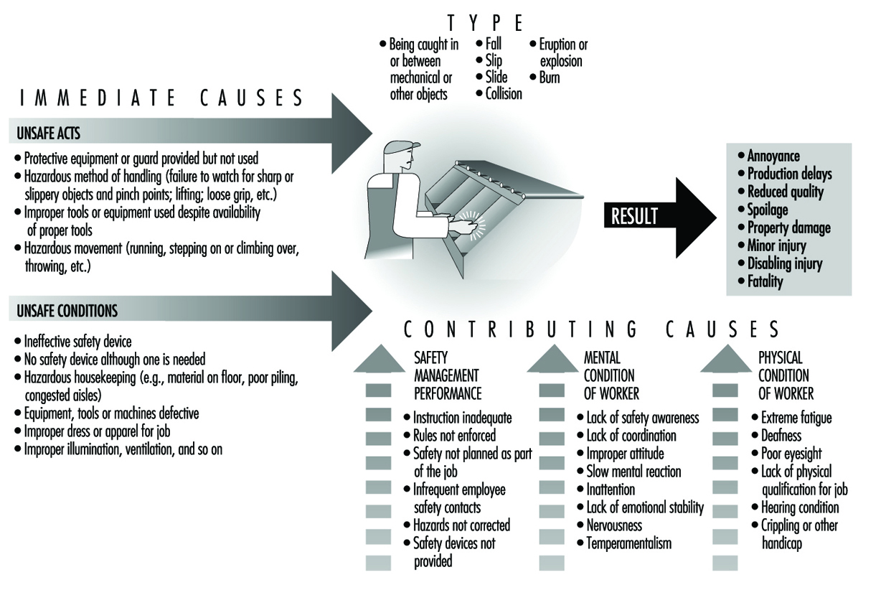
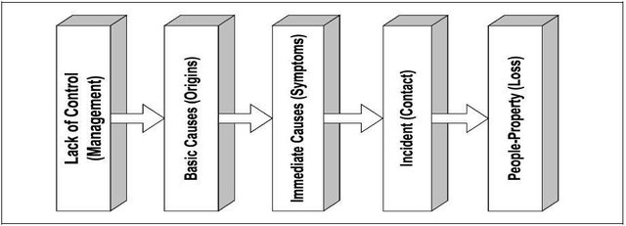
Literature Review
Domino Theory
Theory of Accident Causes
(W.H. Heinrich , 1931)
Structure of accidents
(Jovanović, J.M. et al , 2004)
(Loftus et al , 1974)

Slide 7
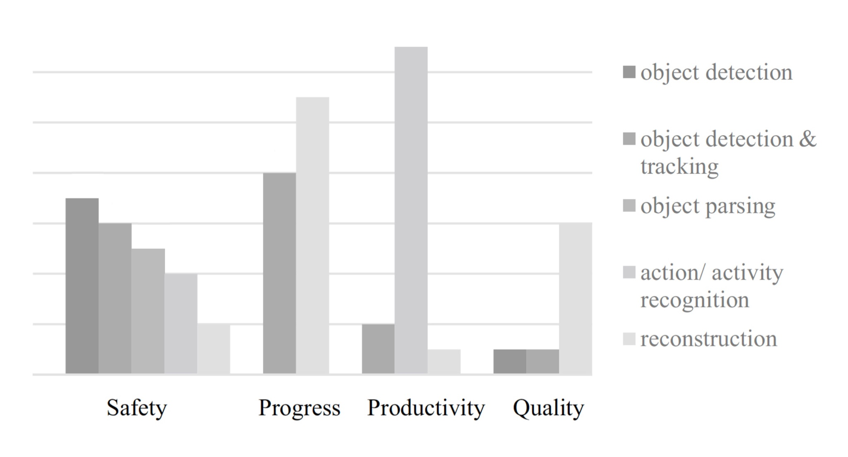
Literature Review
Applications
Distribution of journal articles on different management purposes
Safety
Author | Research | Year
GAO Han et al | Methods of Intrusion Identification in Hazardous Areas Based on Computer Vision | 2019
Run Yu | Computer-vision-based Method for the Recognition of Construction Workers' Unsafe Behaviors | 2019
Mneymneh BE, Abbas M, Khoury H | Vision-based framework for intelligent monitoring of hardhat wearing on construction sites | 2019
Fang Q. et al | Detecting non-hardhat-use by a deep learning method from far-field surveillance videos | 2018
Fang W. et al | Falls from heights: a computer vision-based approach for safety harness detection | 2018
Kolar Z, Chen H, Luo X | Transfer learning and deep convolutional neural networks for safety guardrail detection in 2D images | 2018
Chen J, Fang Y, Cho YK | Real-time 3D crane workspace update using a hybrid visualization approach | 2017
Zhu Z. et al | Predicting movements of onsite workers and mobile equipment for enhancing construction site safety | 2016
Hyunsoo Kim et al | Automated hazardous area identification using laborers' actual and optimal routes | 2016
(Shuyuan Xu et al , 2020)

Slide 8
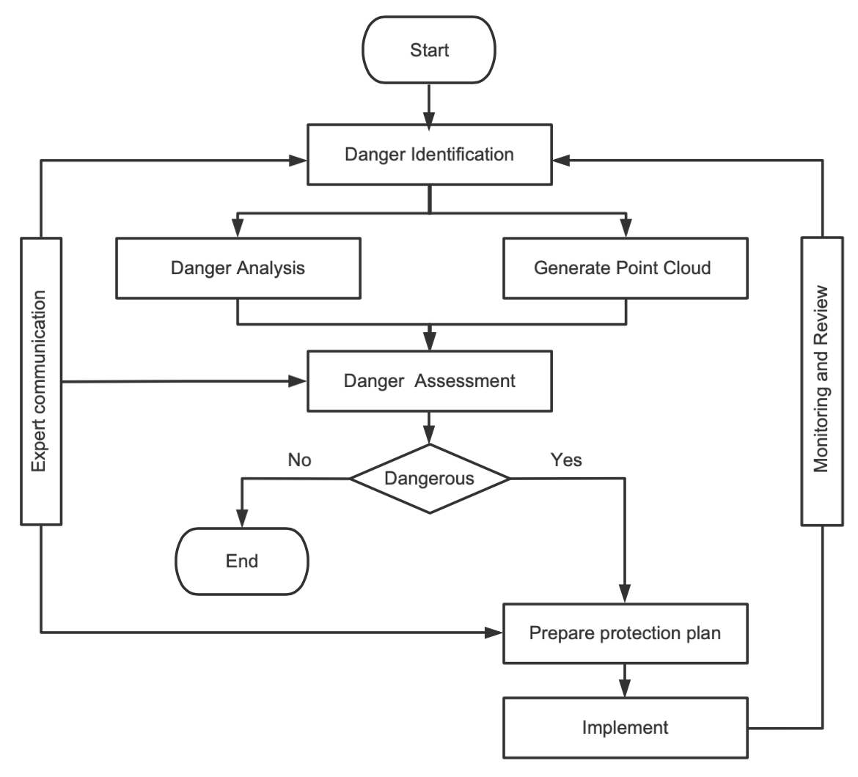
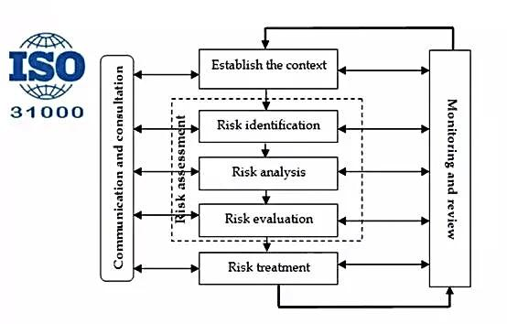
Research Purposes
Identify hazardous areas in construction sites automatically
Decrease the exposure time of hazards and help prevent an accident from occurring
Help improve both the effectiveness of the hazard identification process and enhance the safety for laborers
(ISO , 2009)

Slide 9
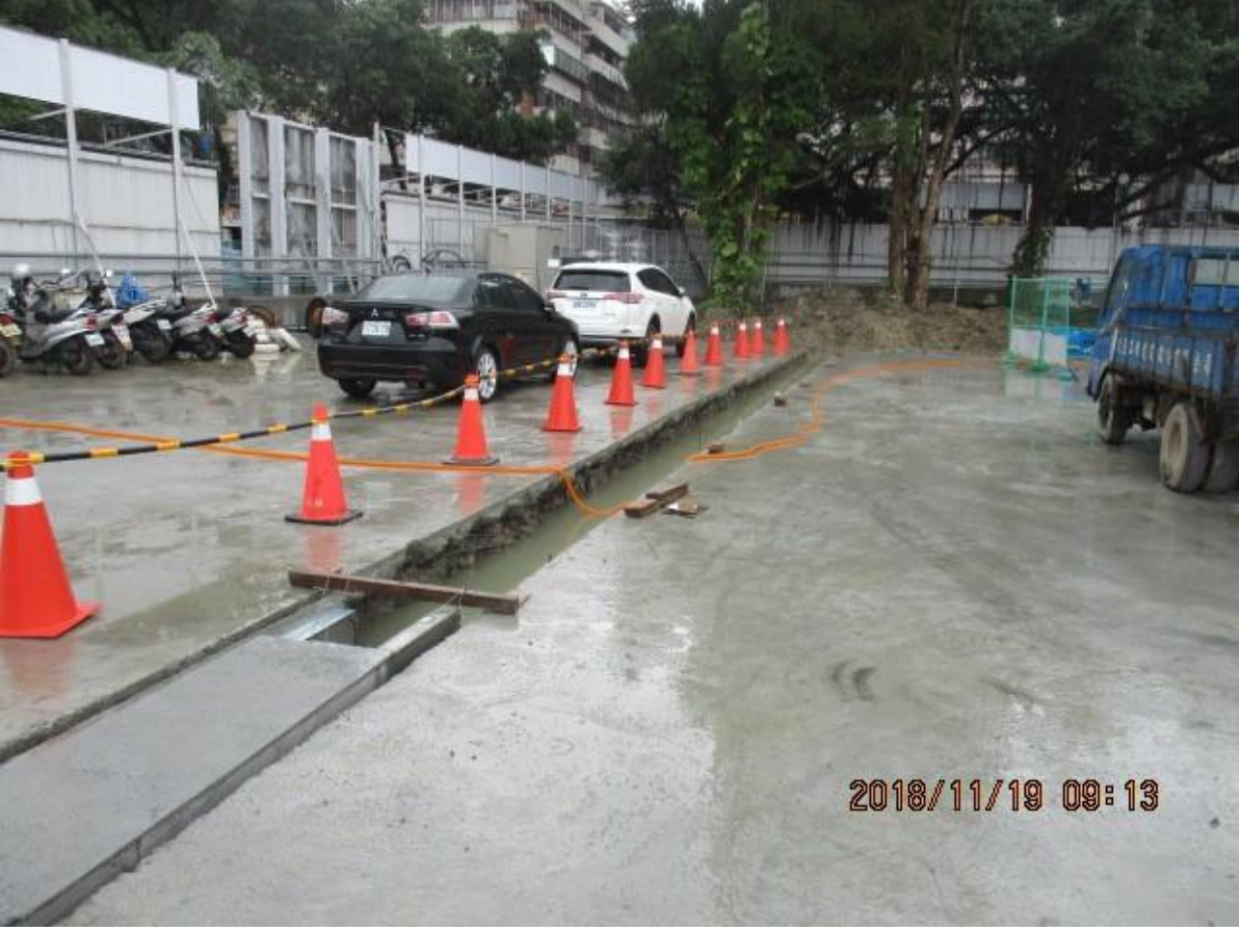
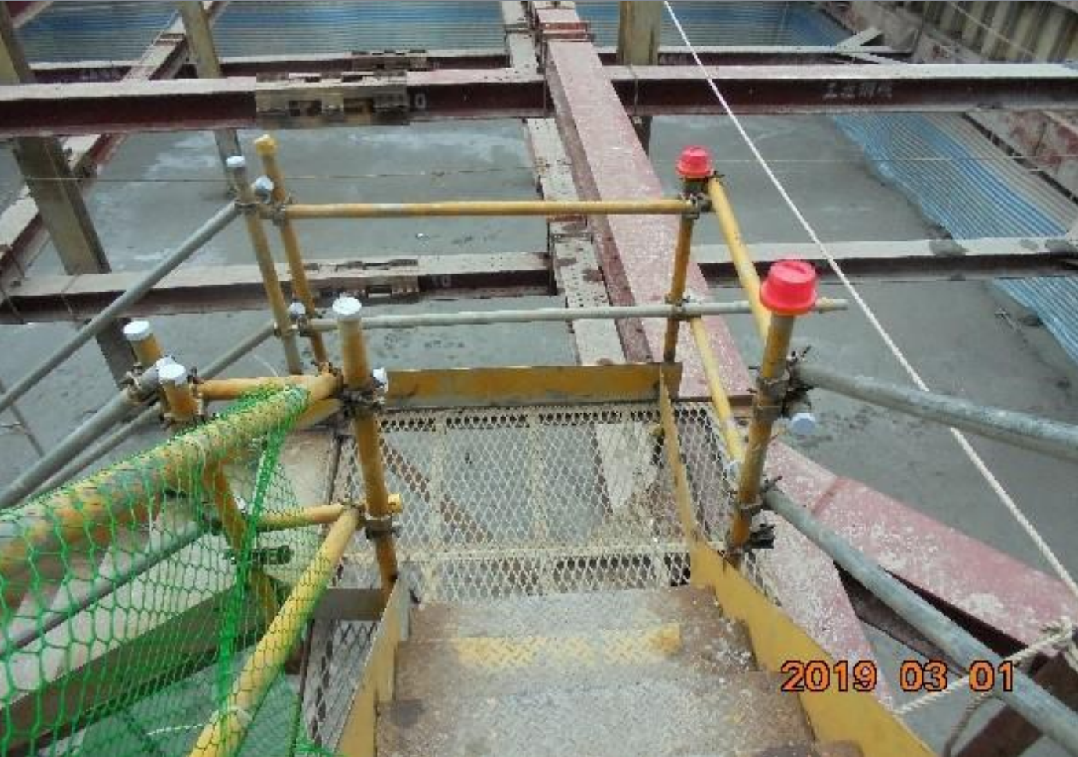
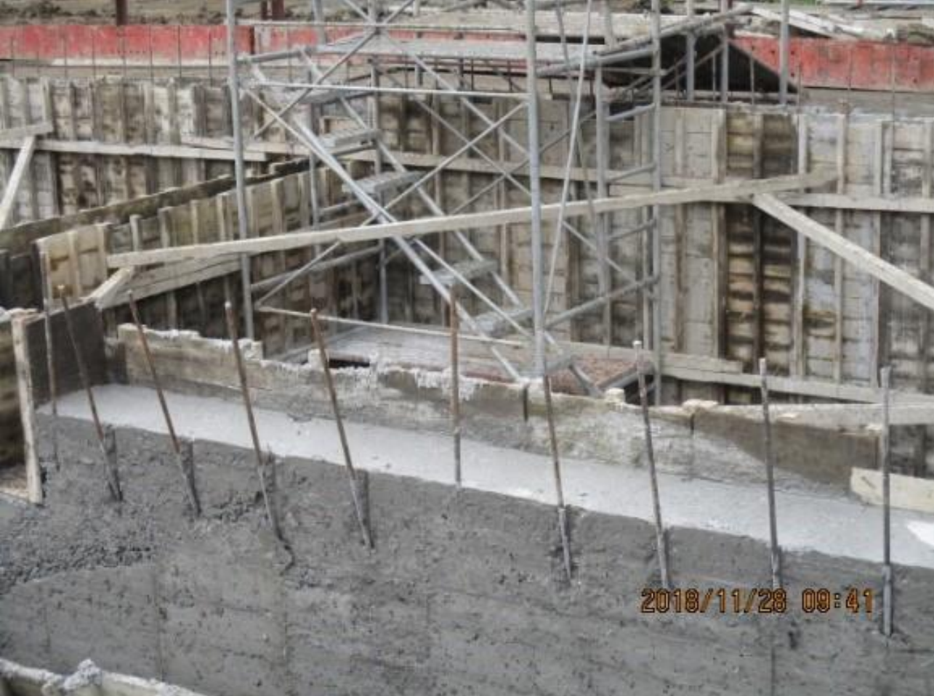
“Dangerous” Zone?
These are some areas that we categorize as “dangerous” and labelled on our training dataset
Zones that have high possibility to slip/ fall
Unclosed pit/ hole
Sticking out steel rod

Slide 10


Data Categorization
dangerous
images
safe
362

Slide 11
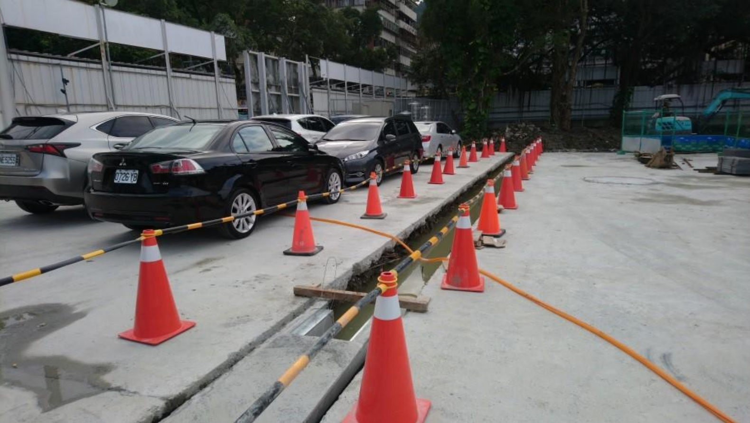
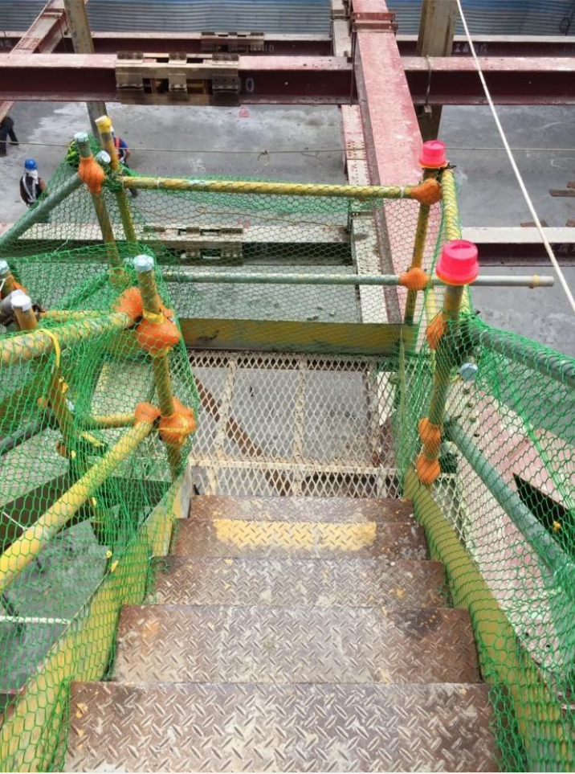
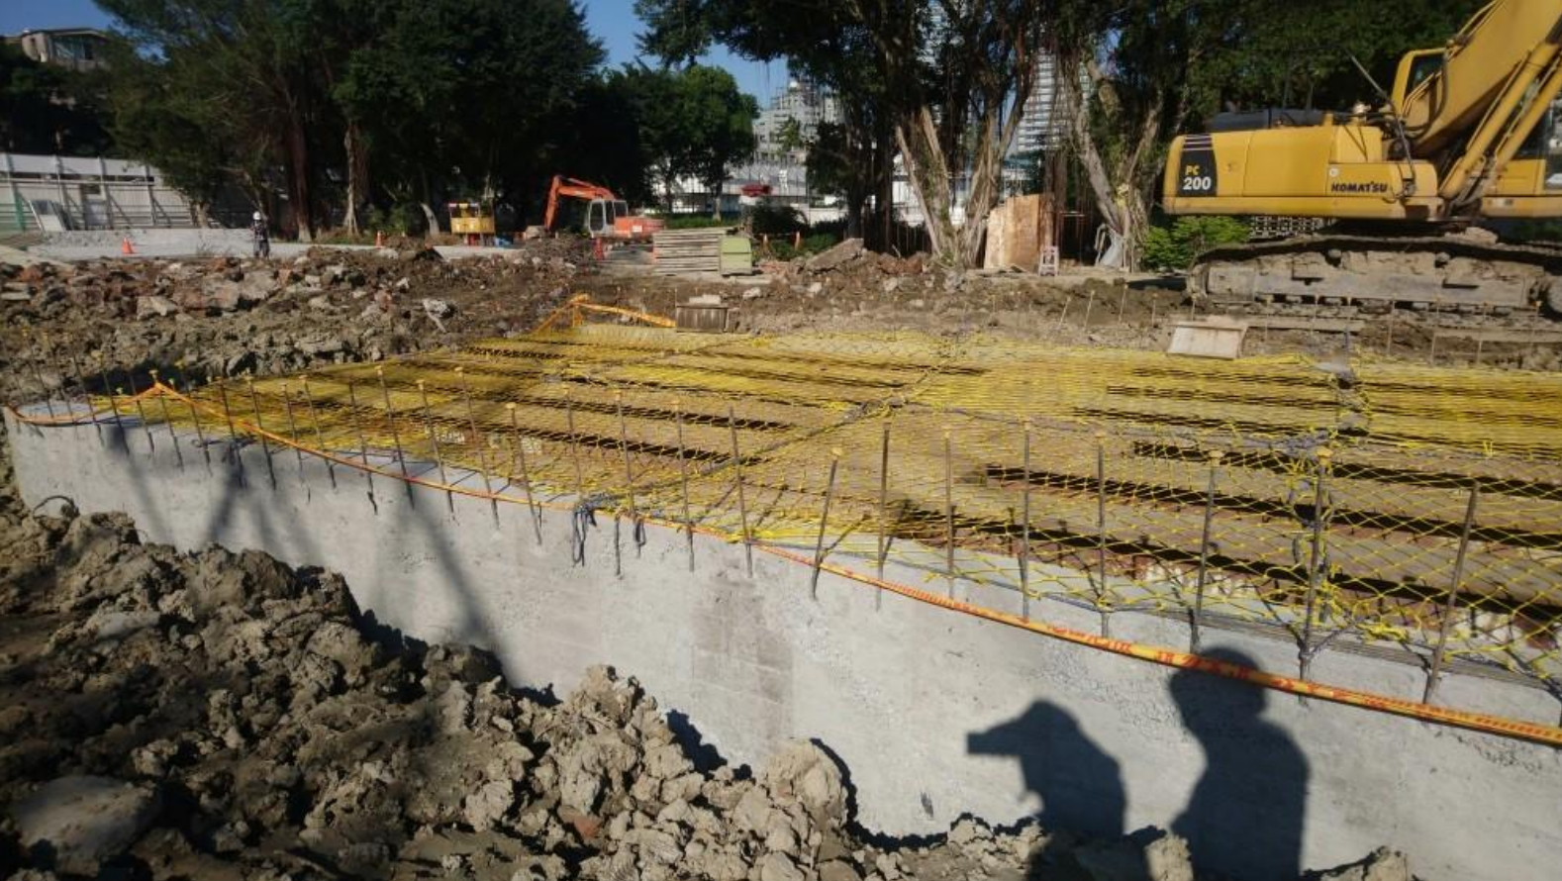
“Safe” Zone?
These are some areas that already improved measures in terms of safety and we could categorize them as “safe”
Separated by safety cone
Covering by safety nets
Put the cap on the tip of steel rod

Slide 12
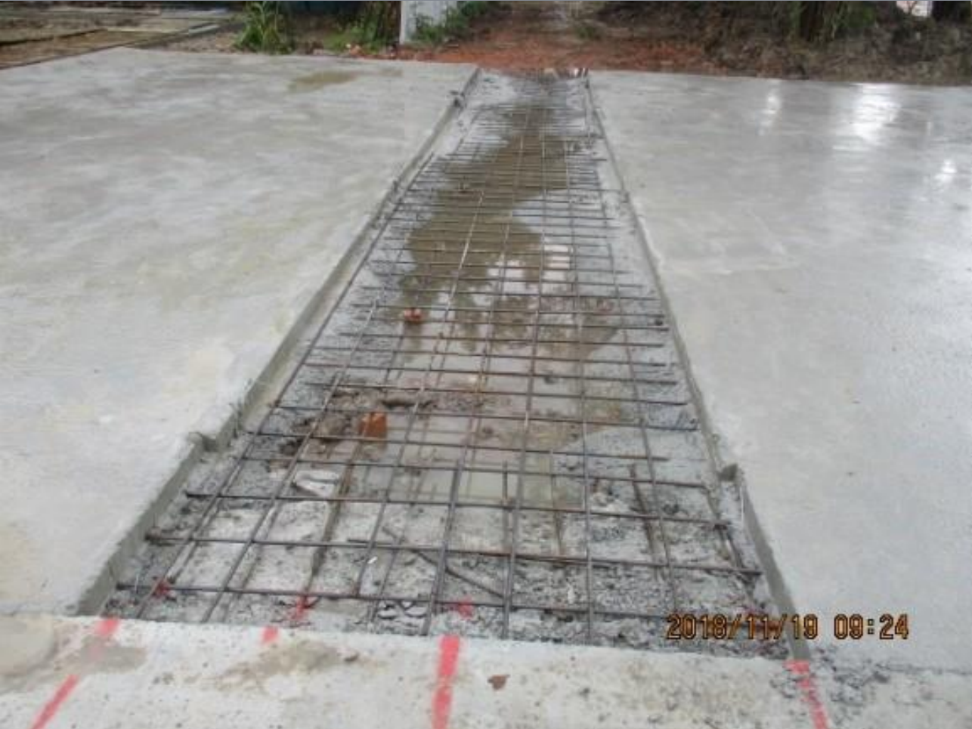
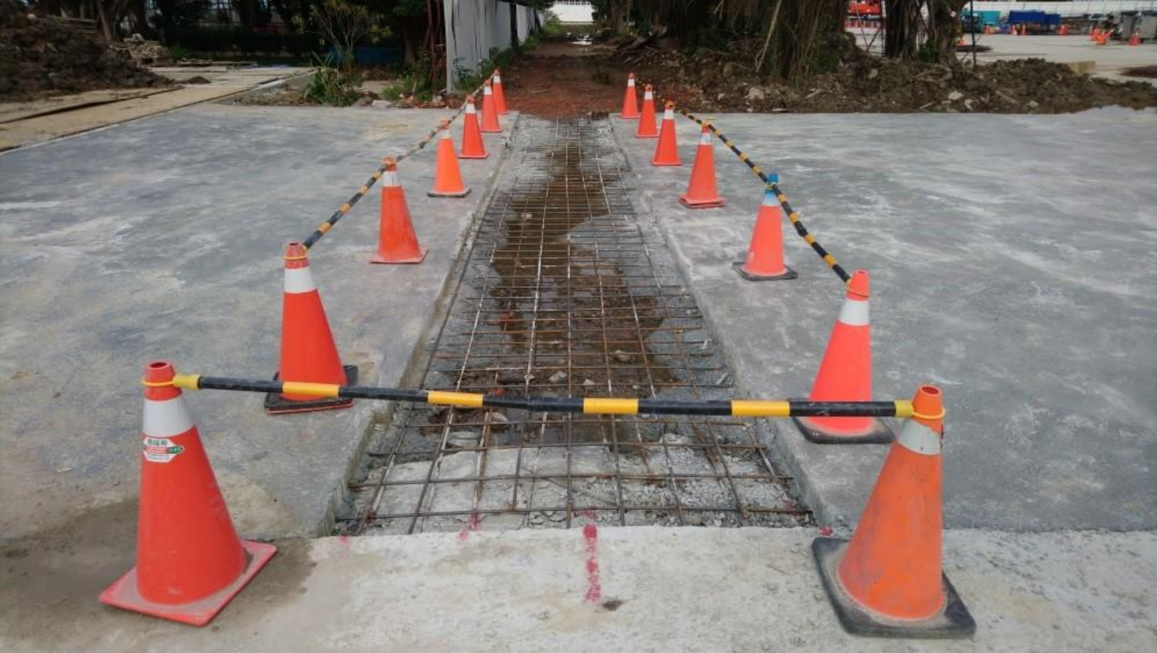
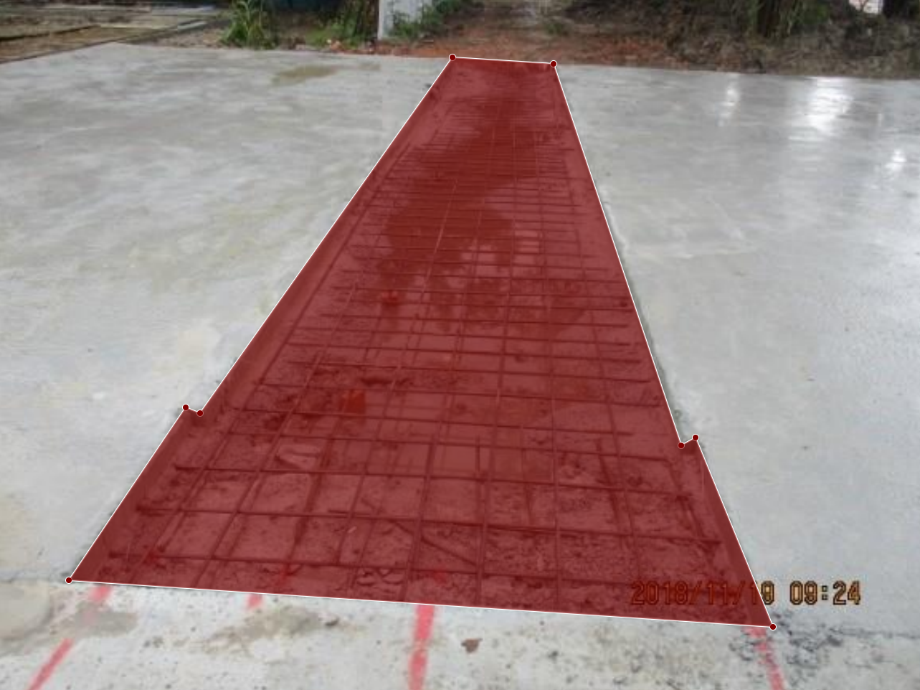
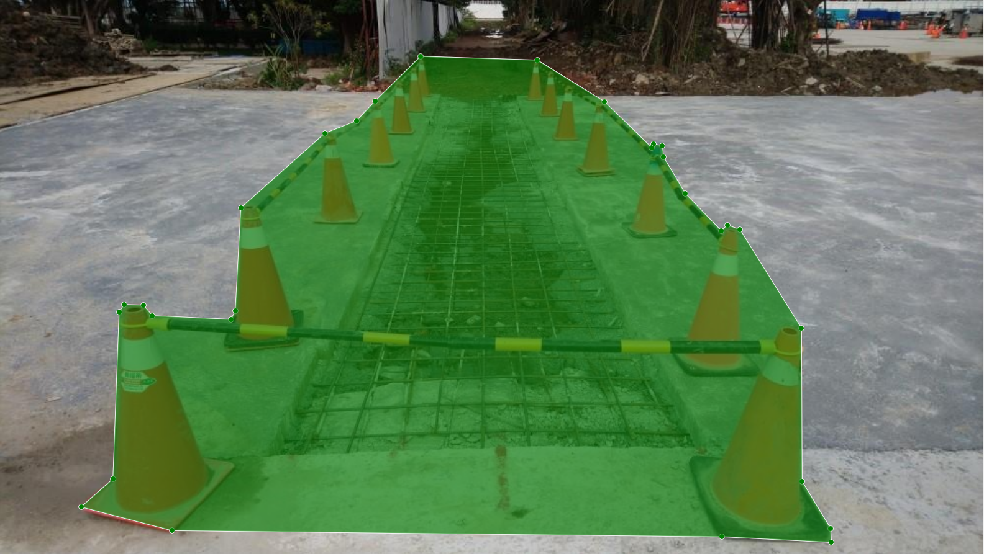
Data Labelling
Original
Danger
Safe
Labelled

Slide 13
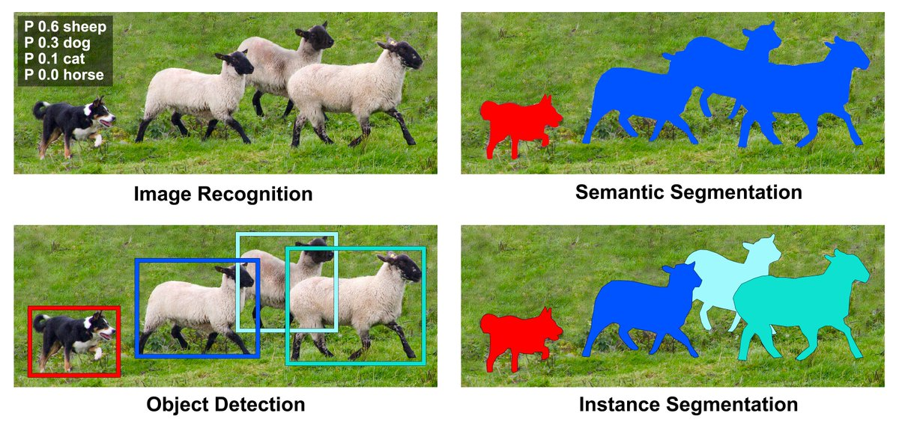
Model training
In order to find potantially dangerous areas, we training an instance segmentation model to detect those areas automatically
Notes:
After data labeling, now we have 360 image-mask pairs as our training data.
In order to find potantially dangerous area, we training an instance segmentation model to detect those areas automatically.
There are mainly four types of task in the graphics application of machine learning
Image recognition is simply to identify objects in the image, while object detection mark their location with a bounding box.
semantic segmentation and instance segmentation both need to classify every pixel
The difference between them is instance segmentation distinguish each individual while semantic segmentation don’t
In our application, both semantic segmentation and instance segmentation model meet the requirements

Slide 14
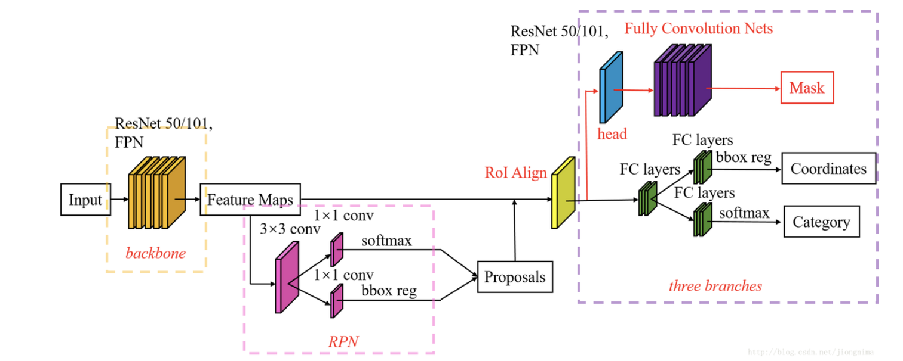
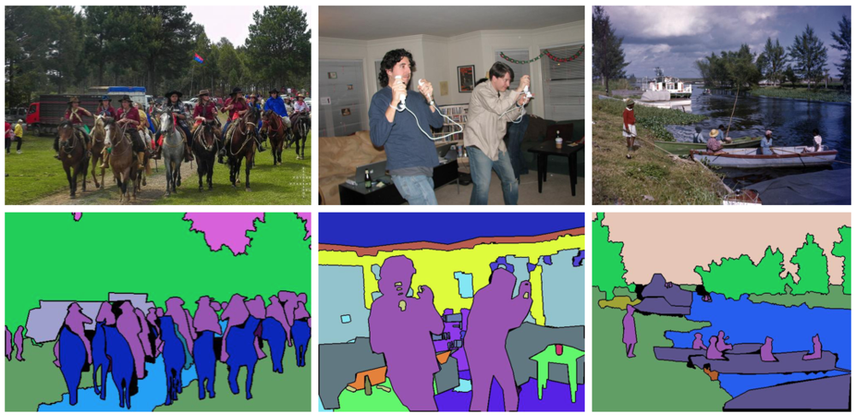
Model training
We choose Mask R CNN as our instance segmentation model, which had pre-trained on COCO dataset.
Coco dataset
Mask R CNN model
Notes:
We choose Mask R CNN as our training model, which had pre-trained on COCO dataset.
coco dataset is the abbreviation of Common Object in Context, which is a large-scale labeled image dataset available for public use.
And we can take a look at the structure of mask r cnn model
As the picture shows, We can get the predicted bounding box and the mask at the same time when using Mask R CNN

Slide 15
Model training
dataset
We have 360 labeled photos, of which 50 are for validation and 310 are for training
optimizer
We use SGD optimizer ( learning rate = 0.01, momentum = 0.9, weight_decay=0.001
learning rate scheduler
We set a learning rate scheduler which decreases the learning rate by 20 times every 10 epoches
<Note> We do not need to add a mean/std normalization nor image rescaling in the data transforms, as those are handled internally by the Mask R-CNN model.
Notes:
Now we have a basic understanding of Mask R CNN model, I’m going to talk about the detail of model training
We have totally 360 labeled photos, 50 for validation dataset and 310 for training dataset
Next, we use SGD optimizer with parameter using following values
(momentum is parameter which helps accelerate gradients vectors in the right directions, thus leading to faster converging, default = 0.9)
(weight_decay is parameter to prevent the model from overfitting)
Additionally, we set a learning rate scheduler, which decreases the learning rate by 20 times every 10 epoches

Slide 16
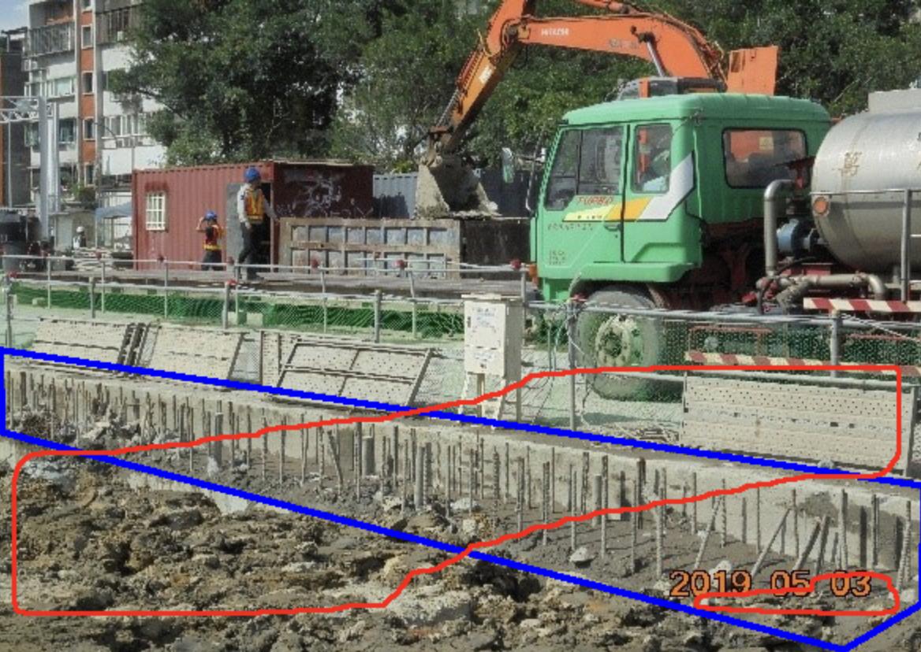
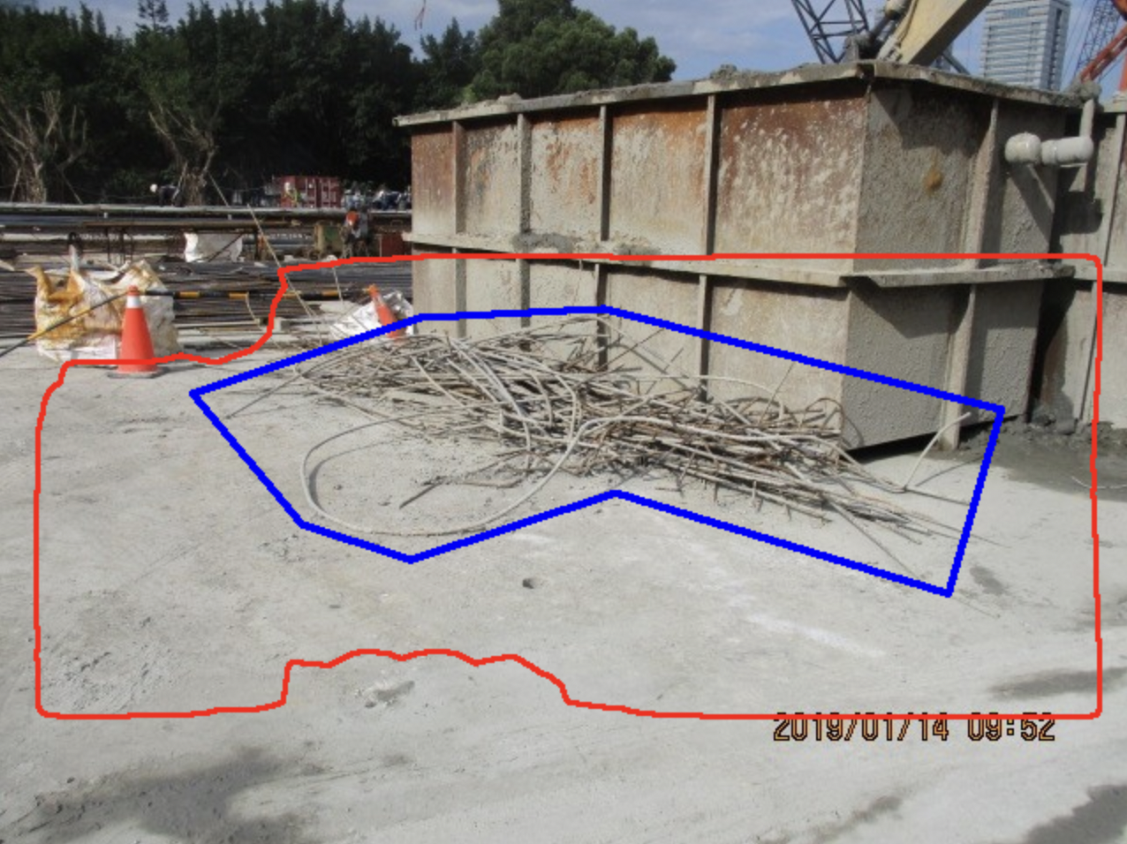
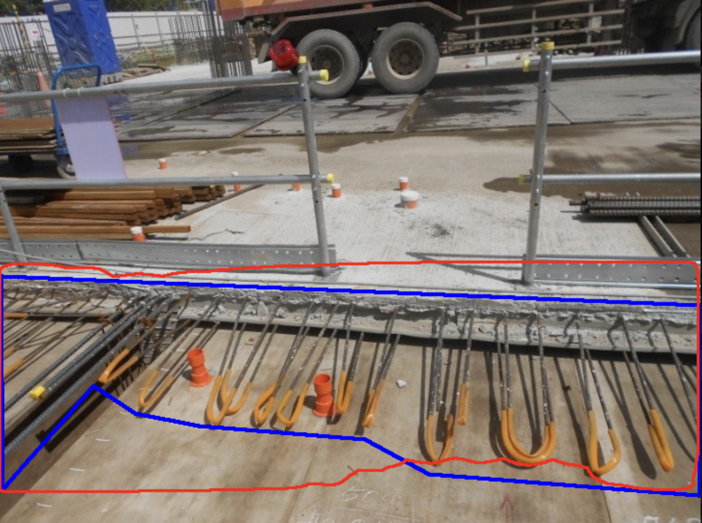
Model training
We run 30 epoches and get Average Precision (AP) = 0.419 in semantic segmentation task.
The following are some photos of the predicted results
labeded
predicted

Slide 17
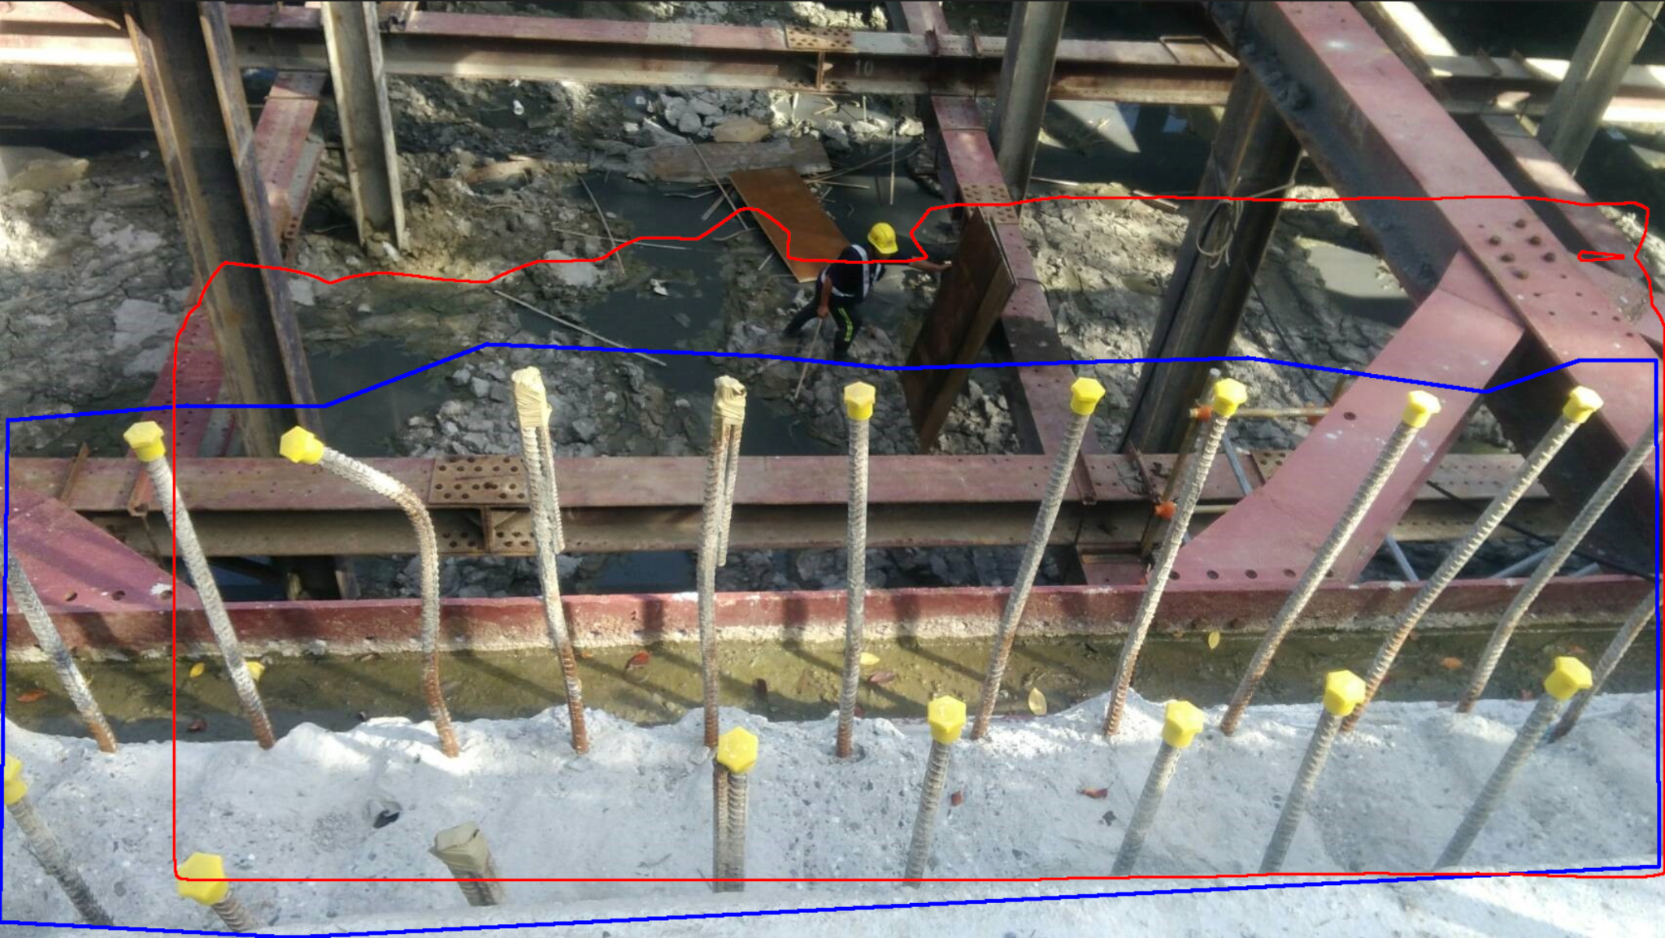
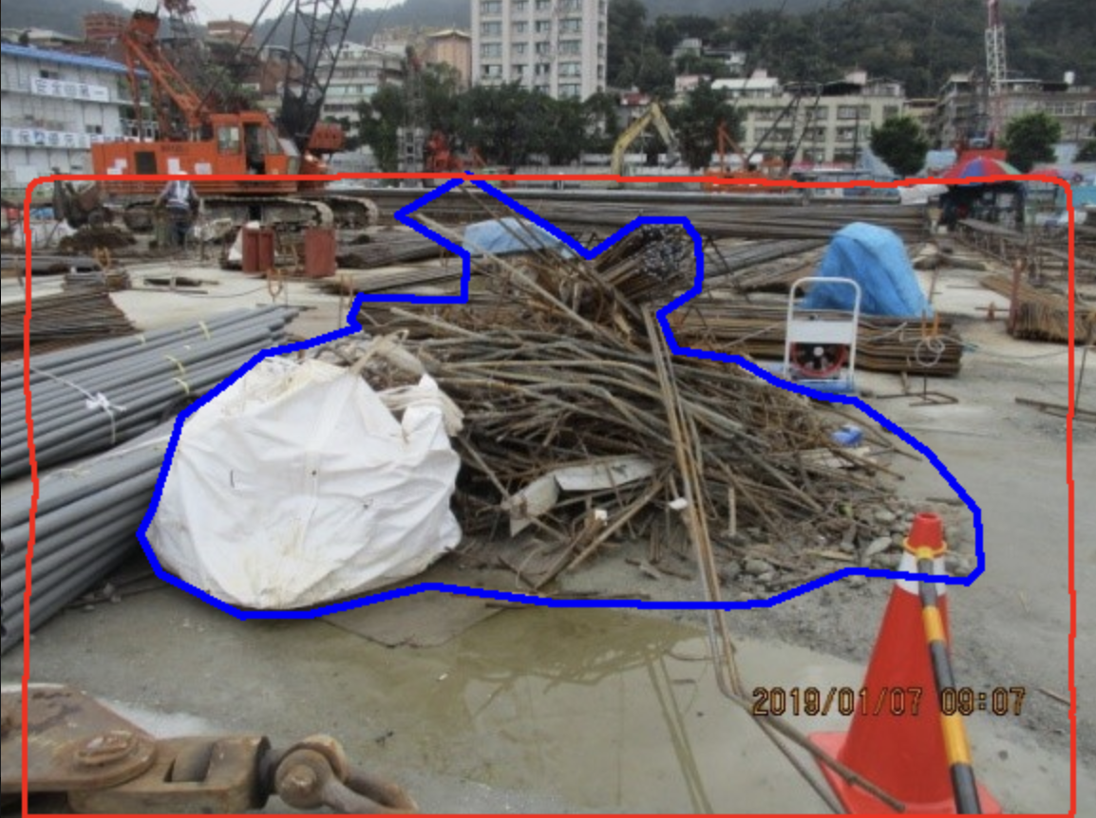
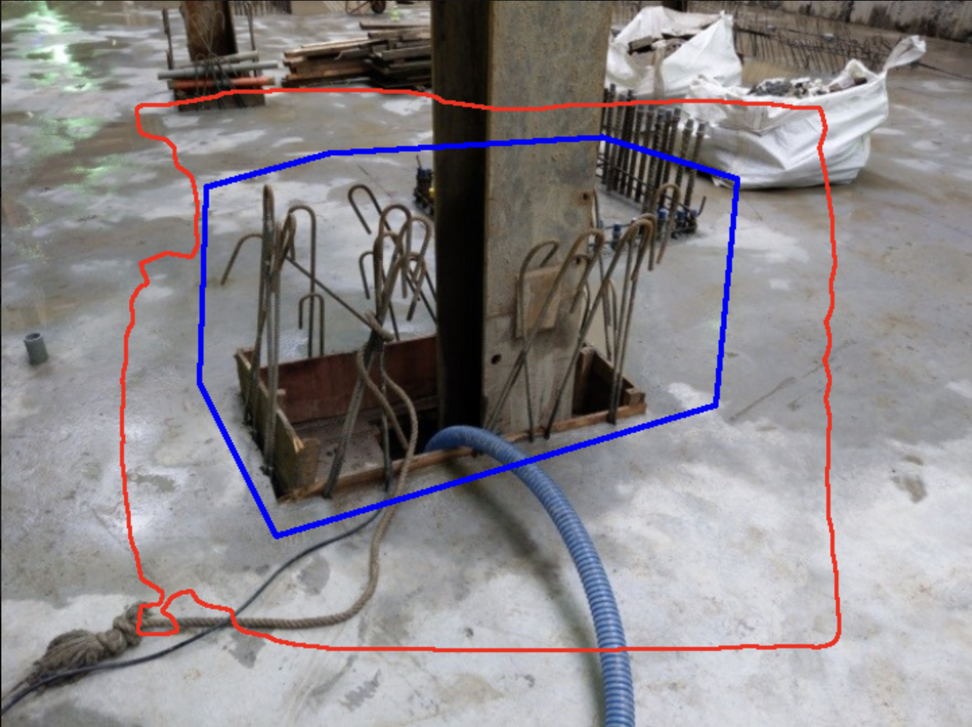
Model training
We run 30 epoches and get Average Precision (AP) = 0.419 in semantic segmentation task.
The following are some photos of the predicted results
labeded
predicted

Slide 18
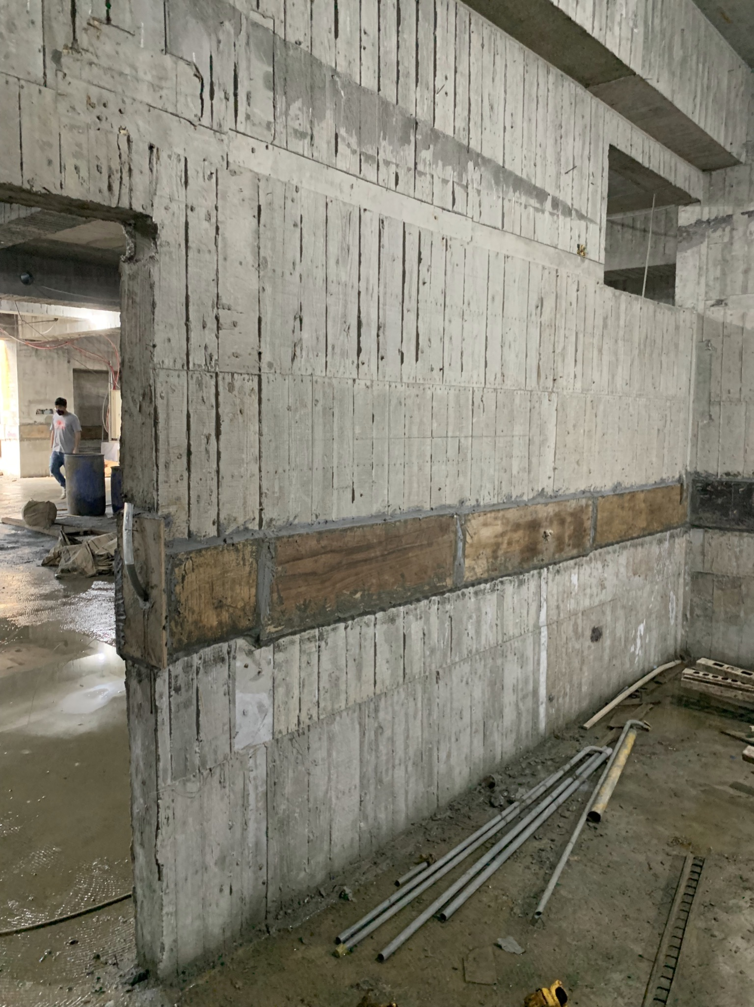
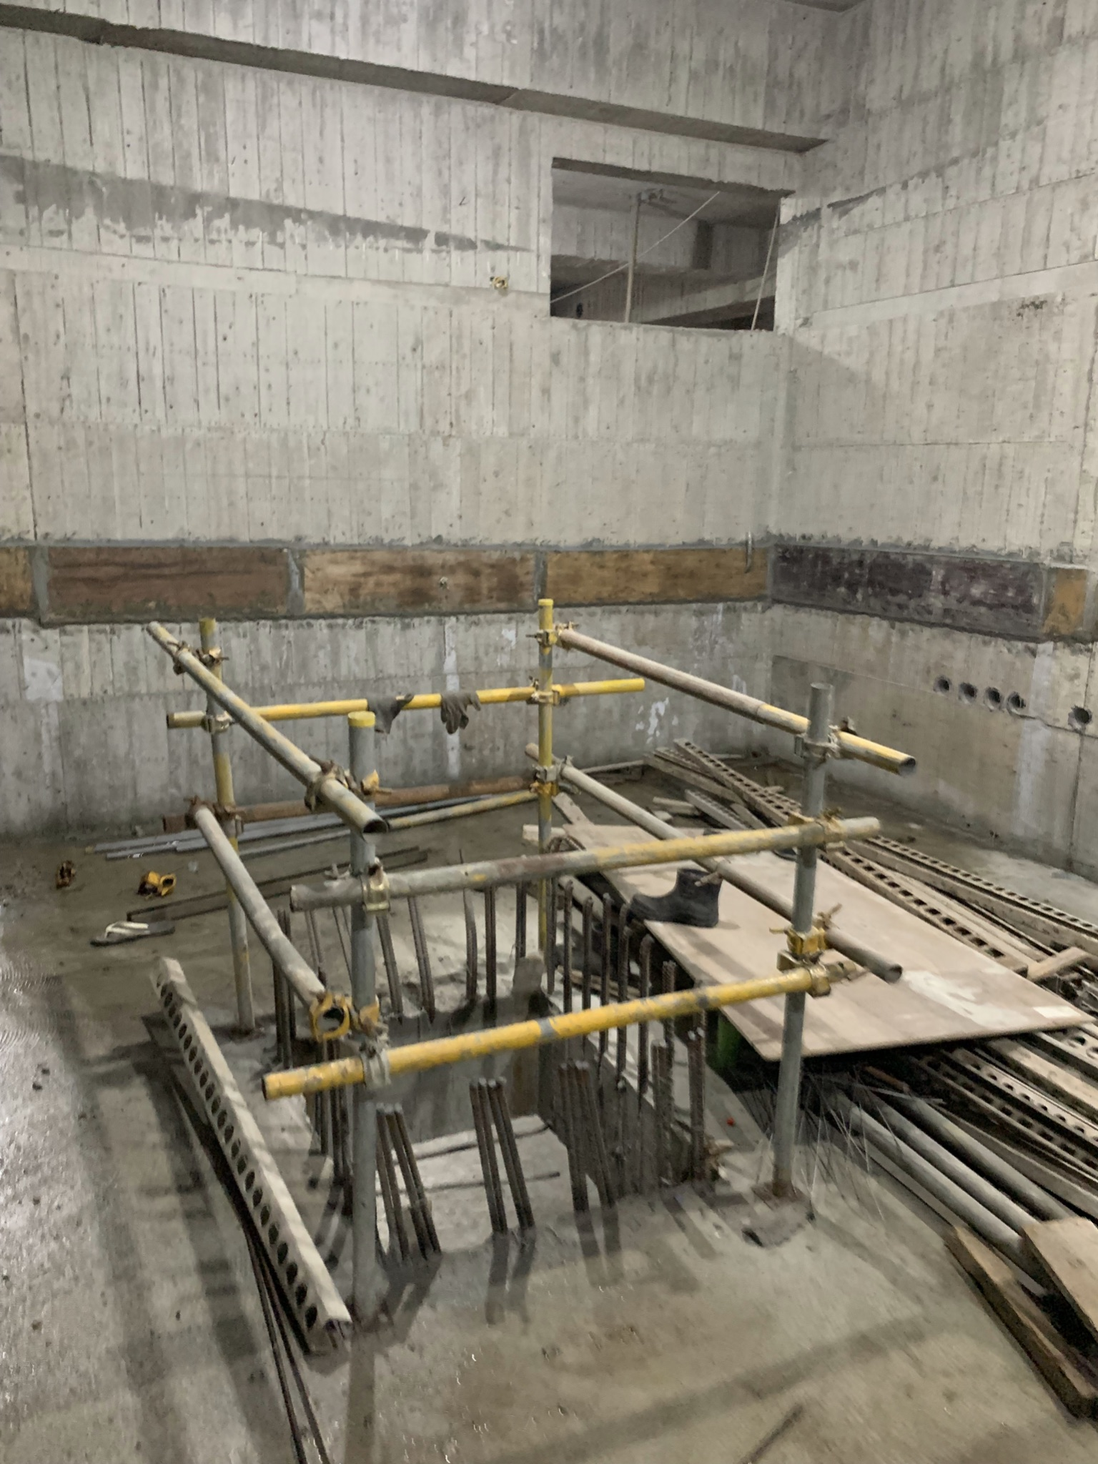
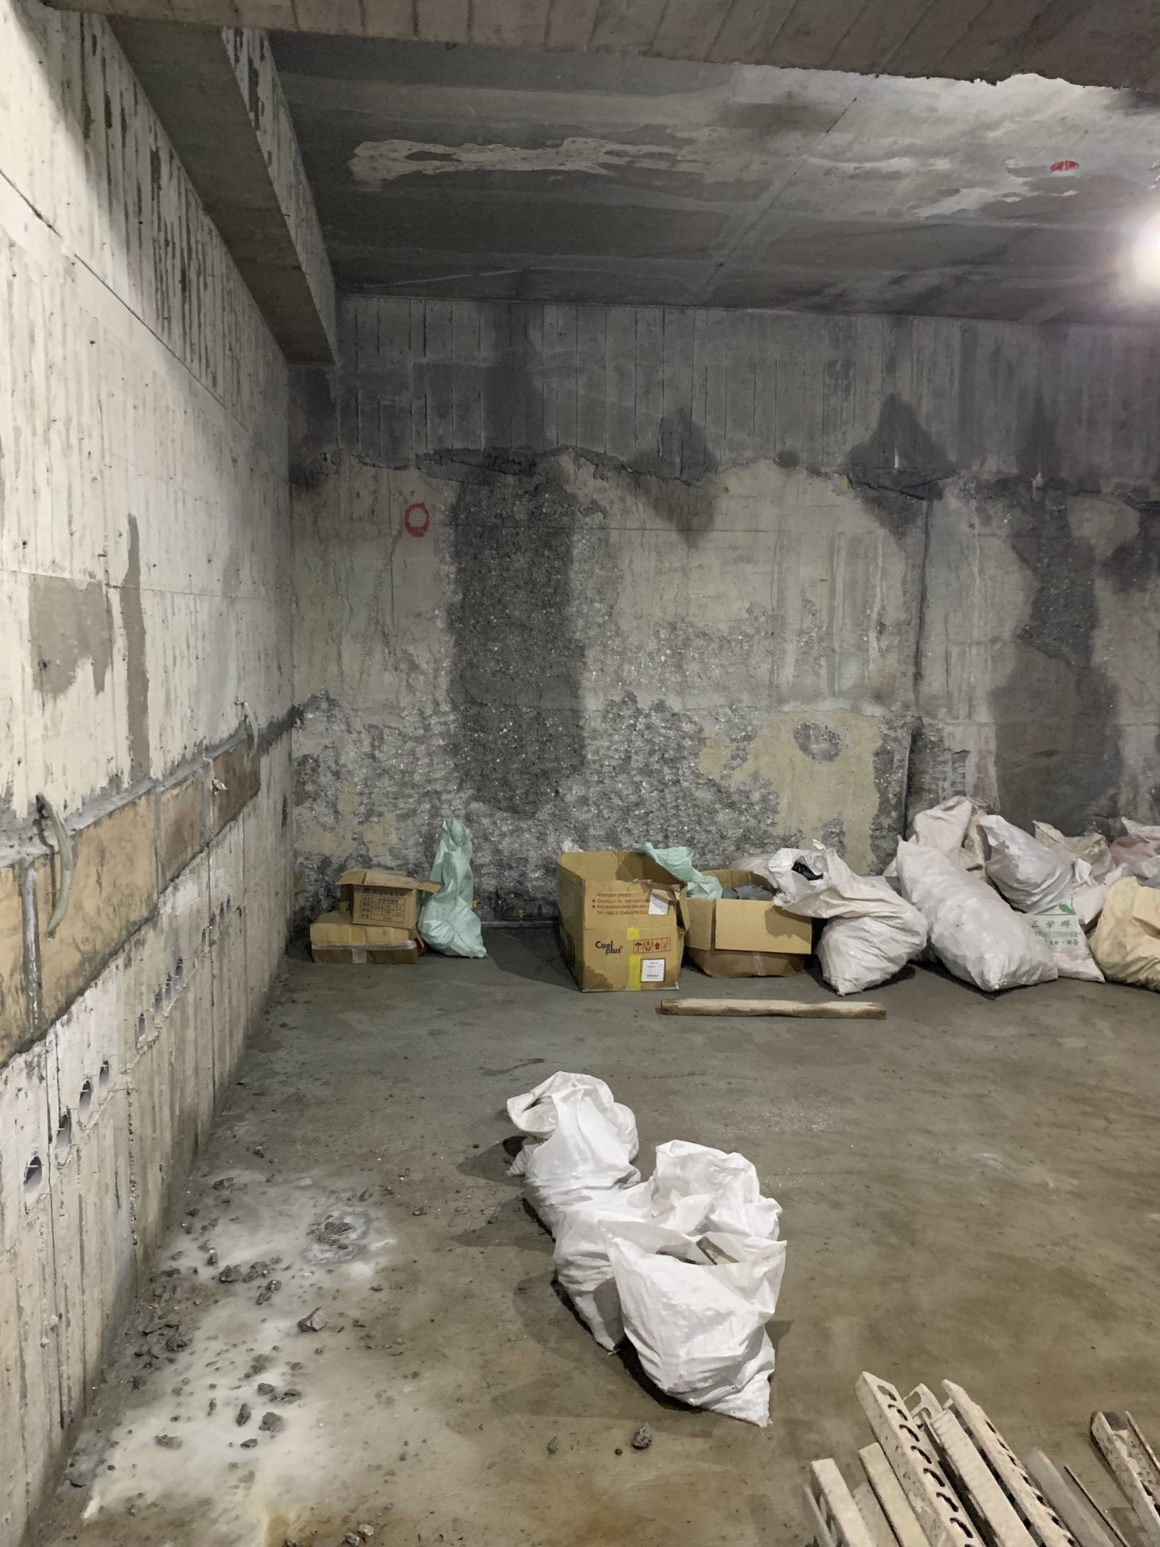
Test Case

Slide 19
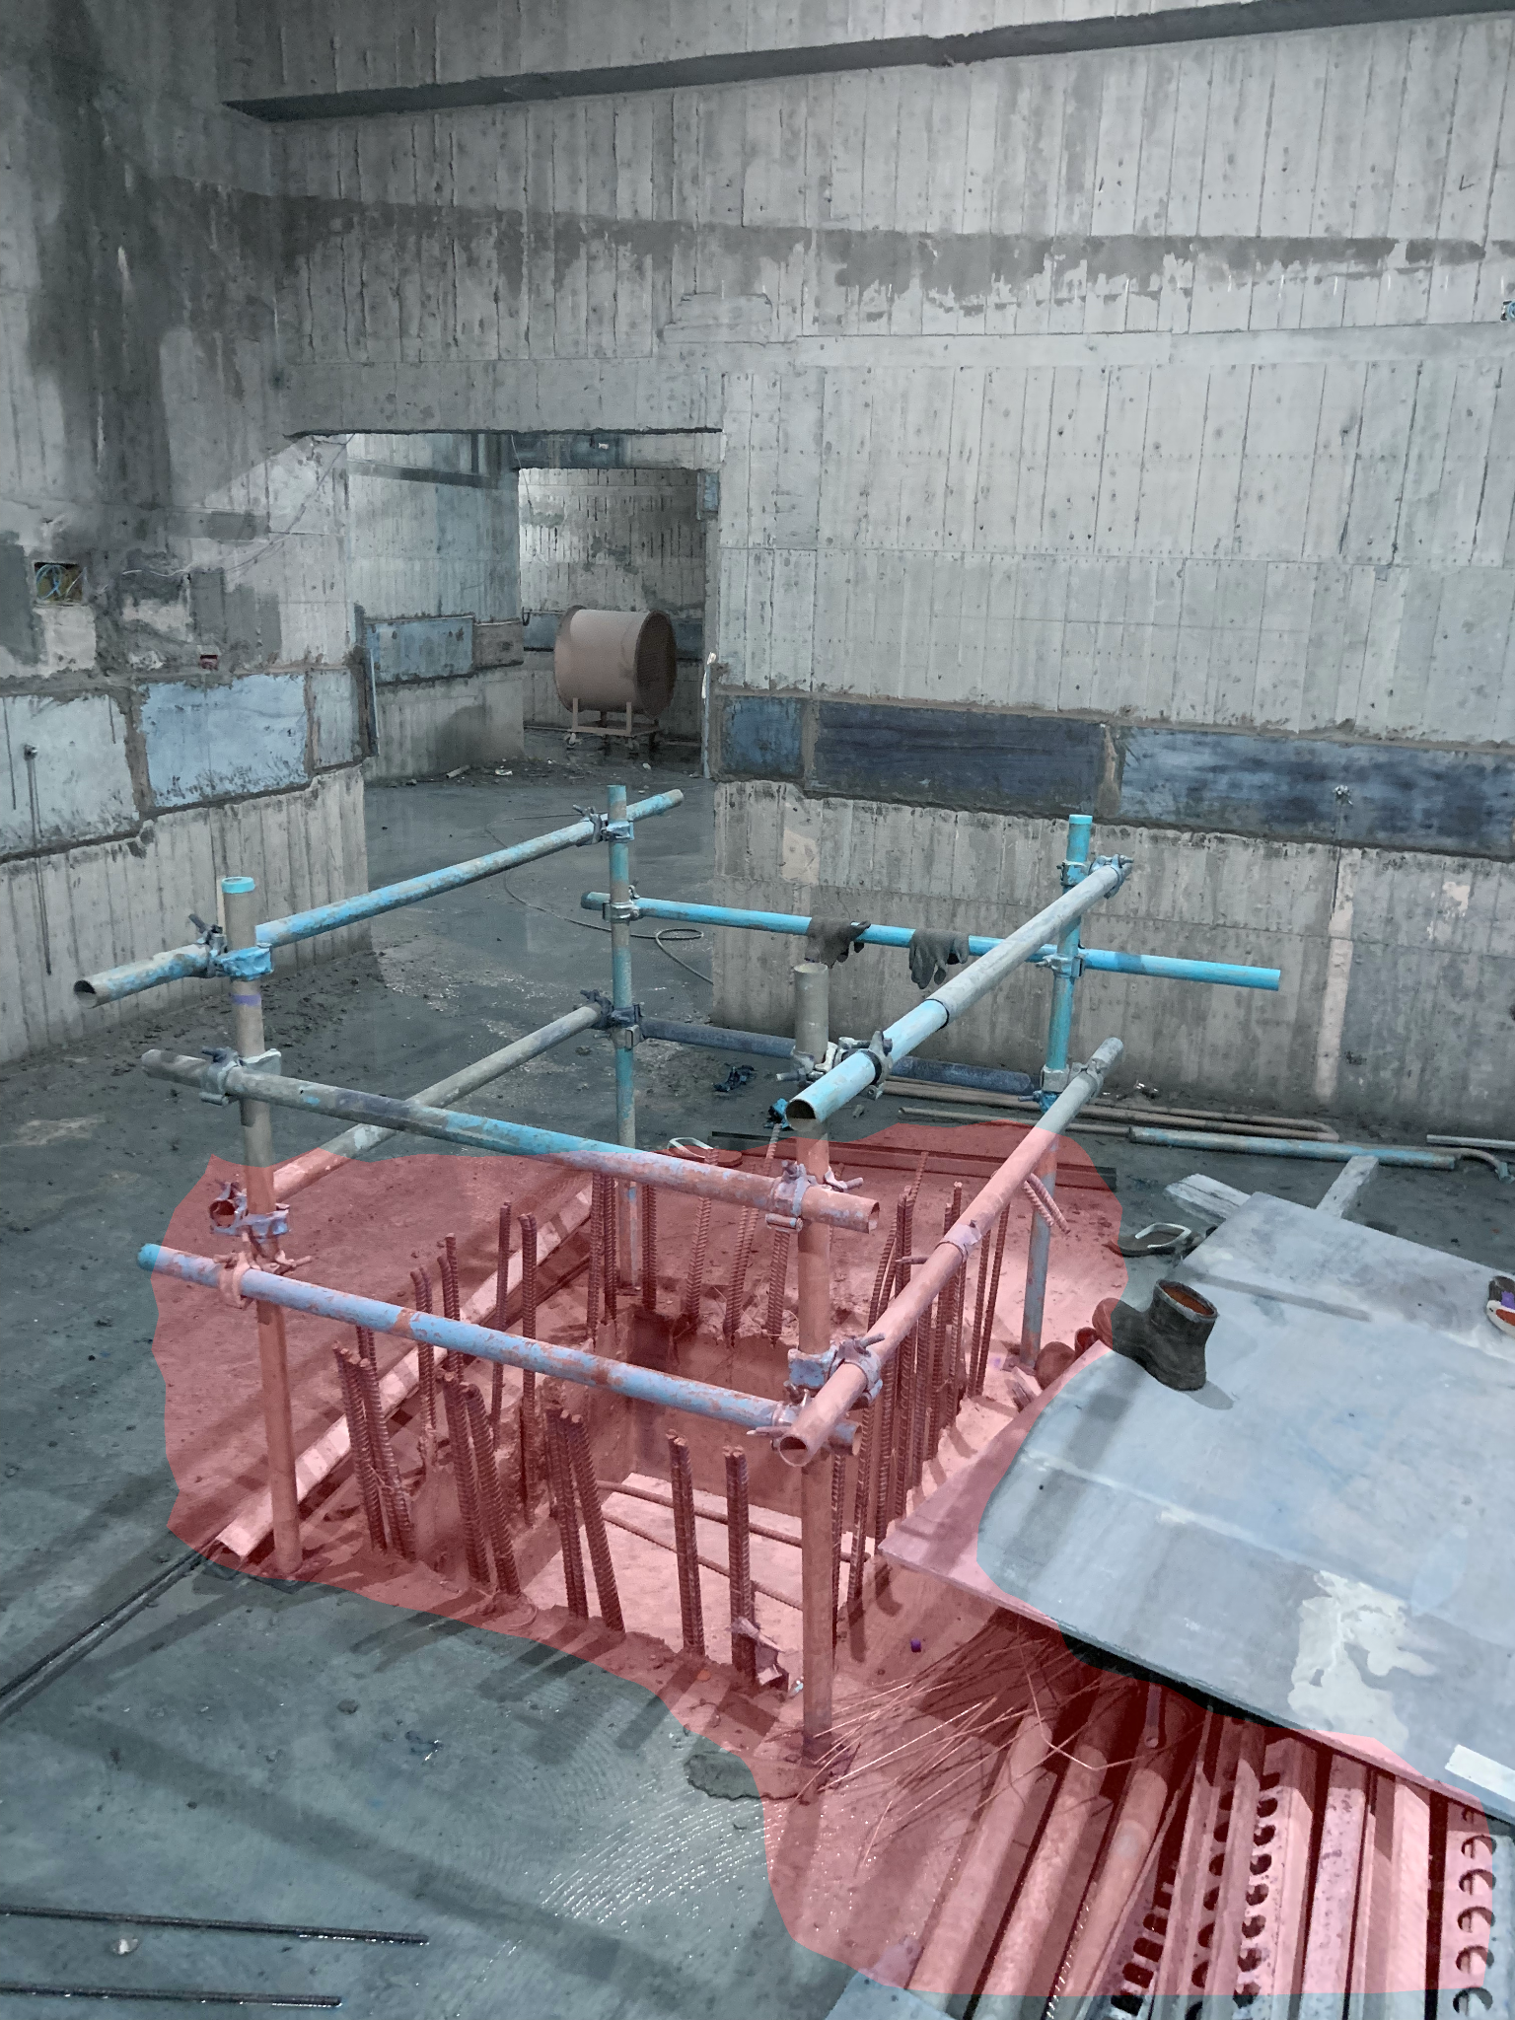
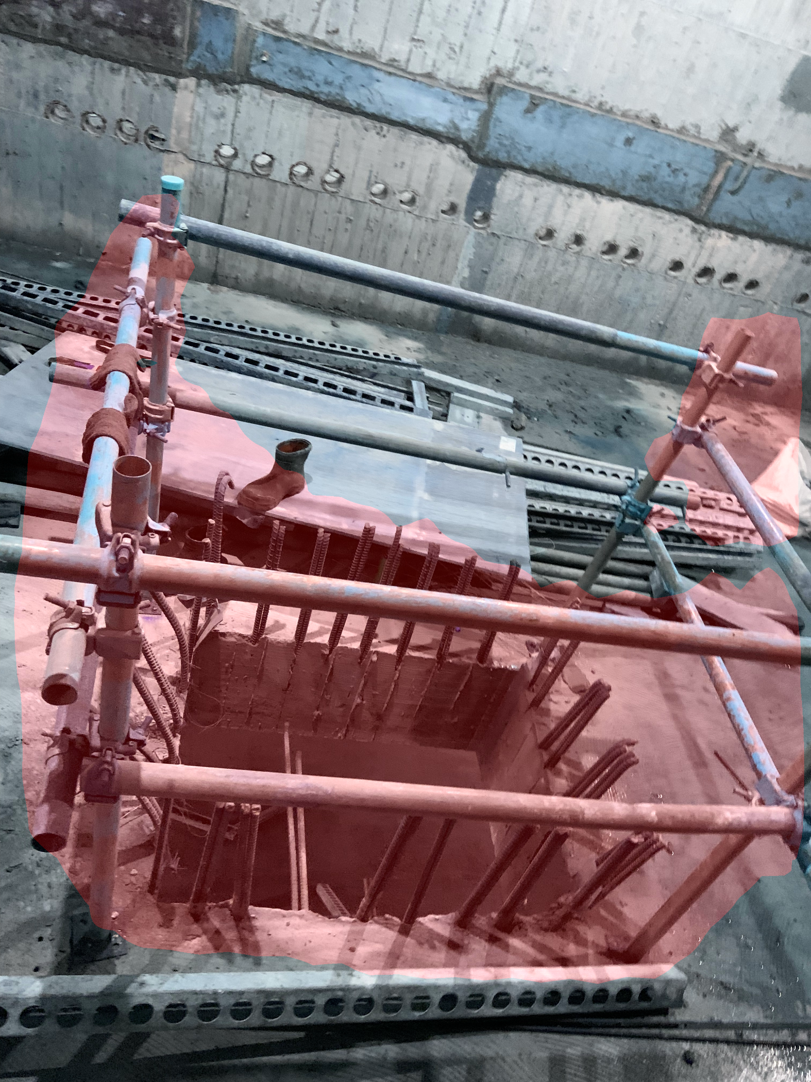
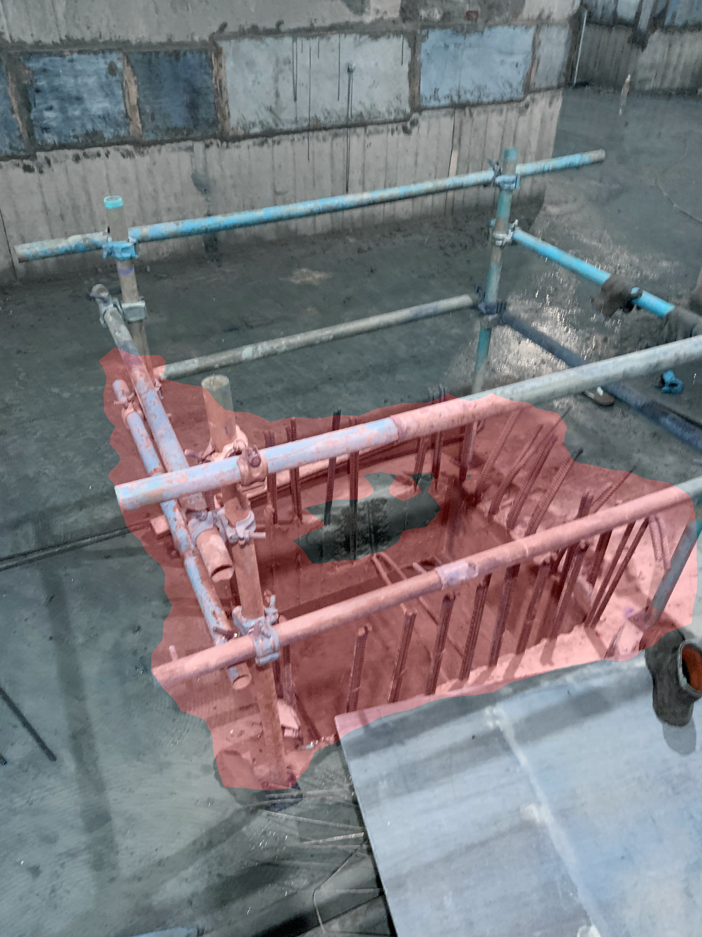
Prediction
predict: confidence=0.85

Slide 20
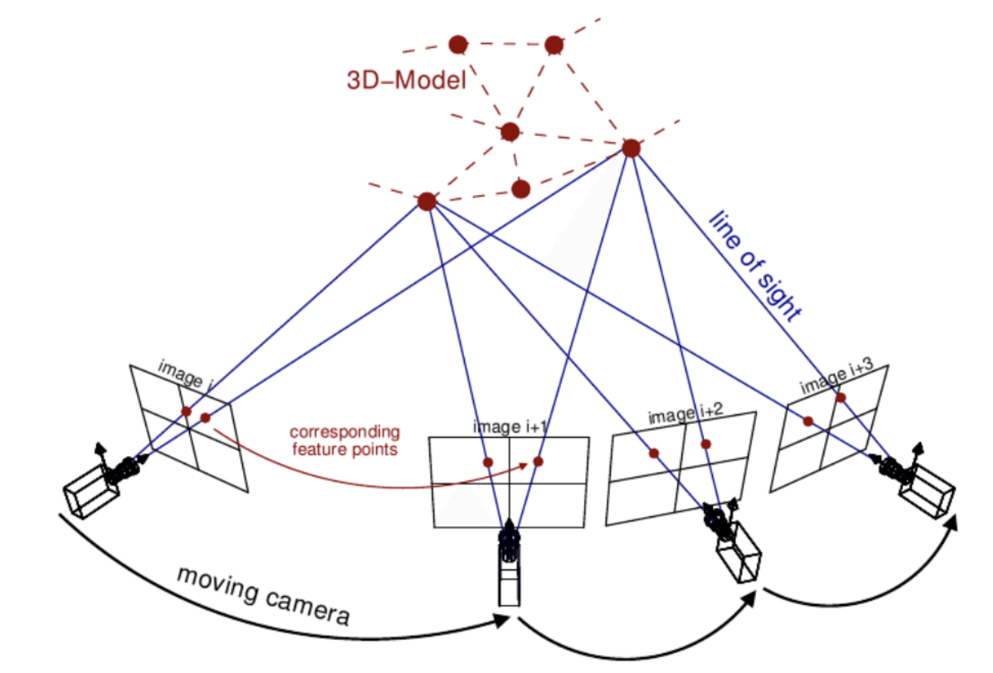
Point Cloud: Generation
Open-SFM
Feature Extraction
Feature Matching
Compute Camera Tracks
Bundle Adjustment
Compute Depthmap
3D Reconstruction

Slide 21
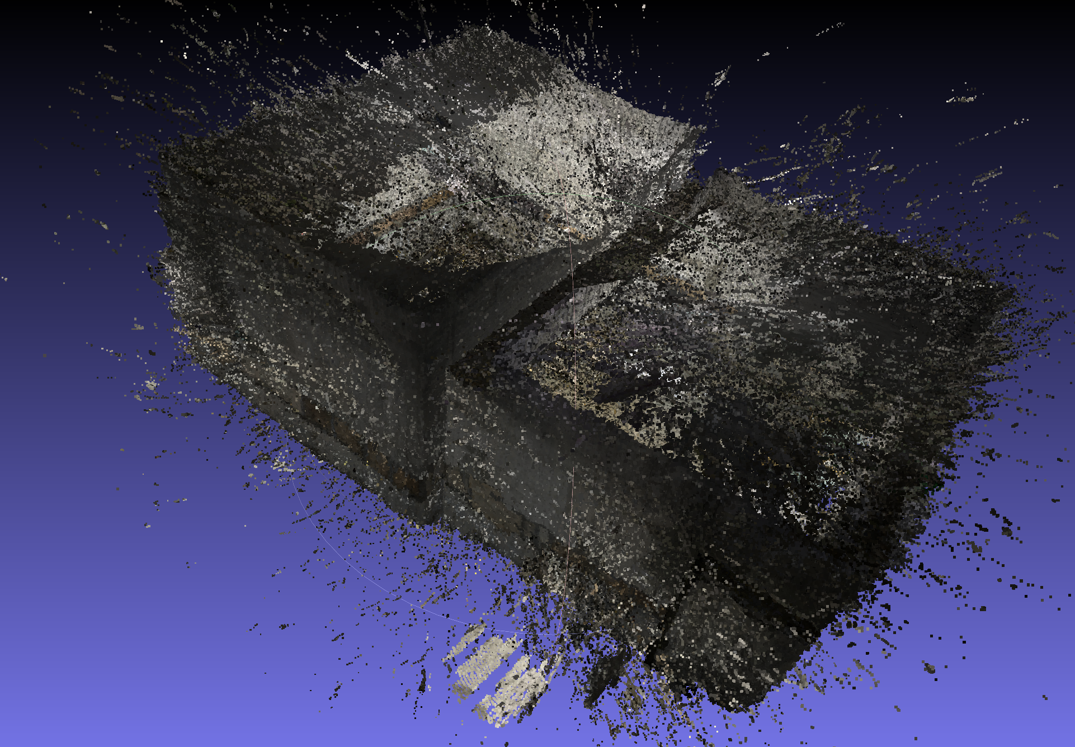
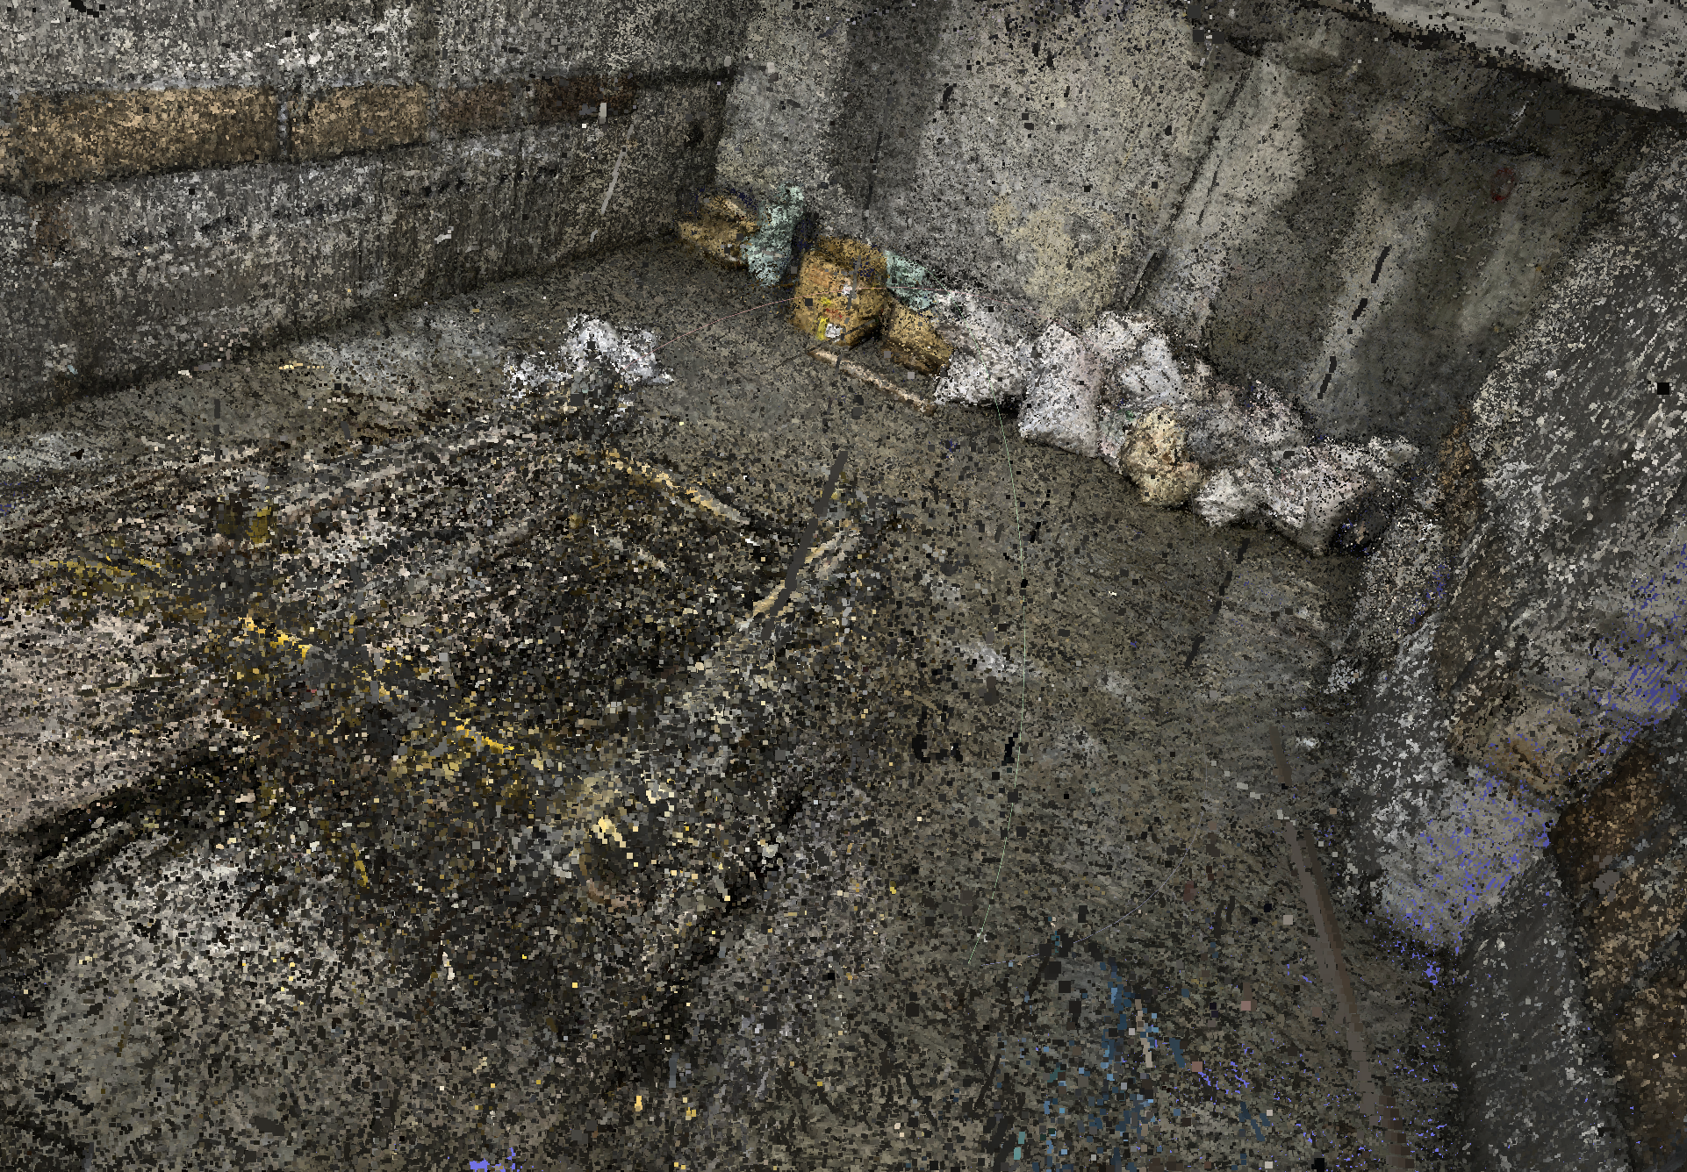
Point Cloud: Generation

Slide 22
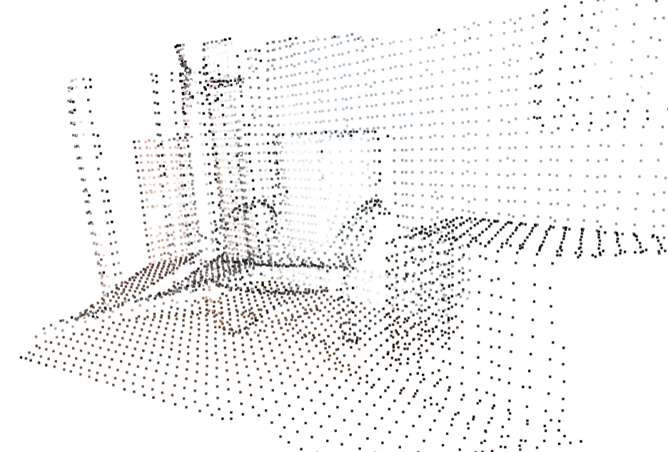
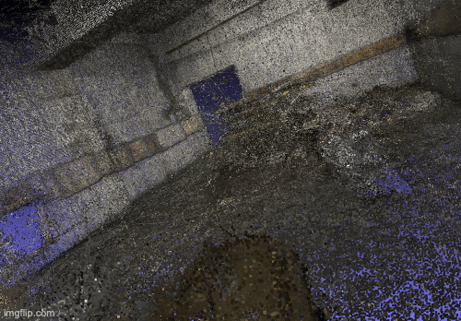
Point cloud: downsample
Points are bucketed into voxels.
Each occupied voxel generates exactly one point by averaging all points inside.
Parameter:
voxelsize=4cm
14704365 points
→2367650 points
16%

Slide 23
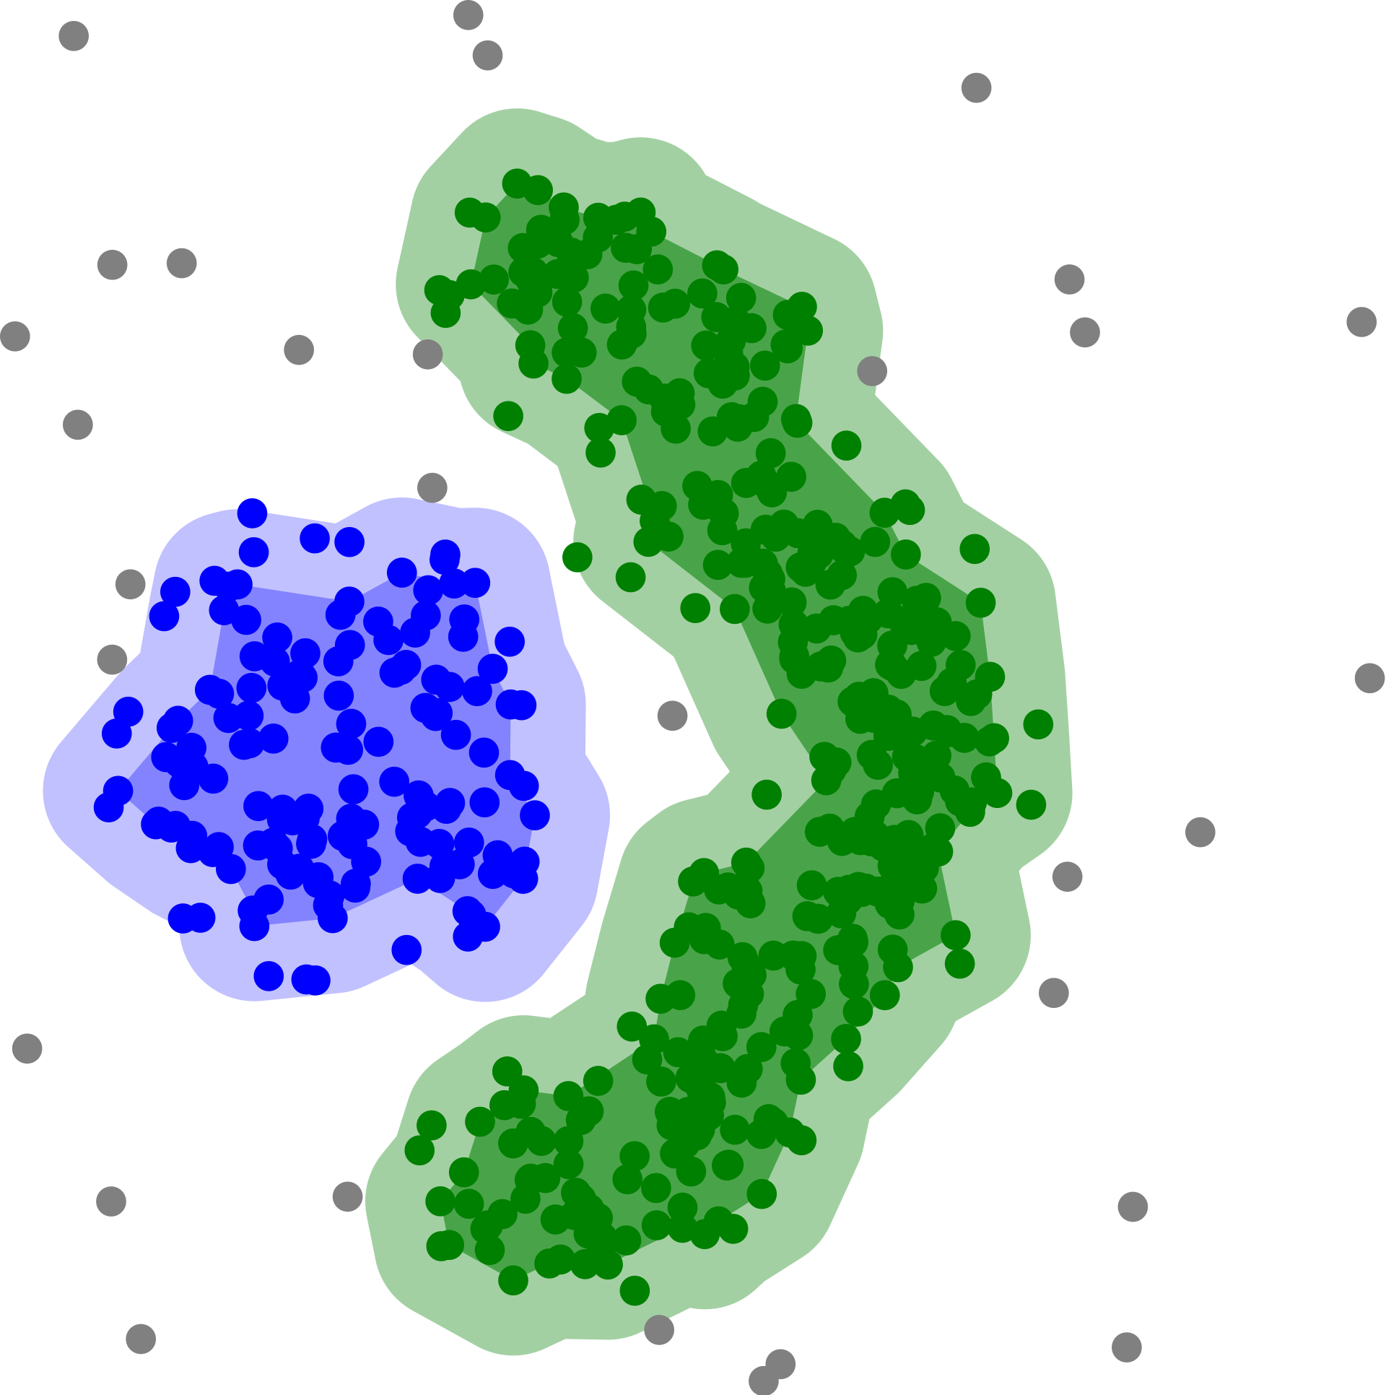
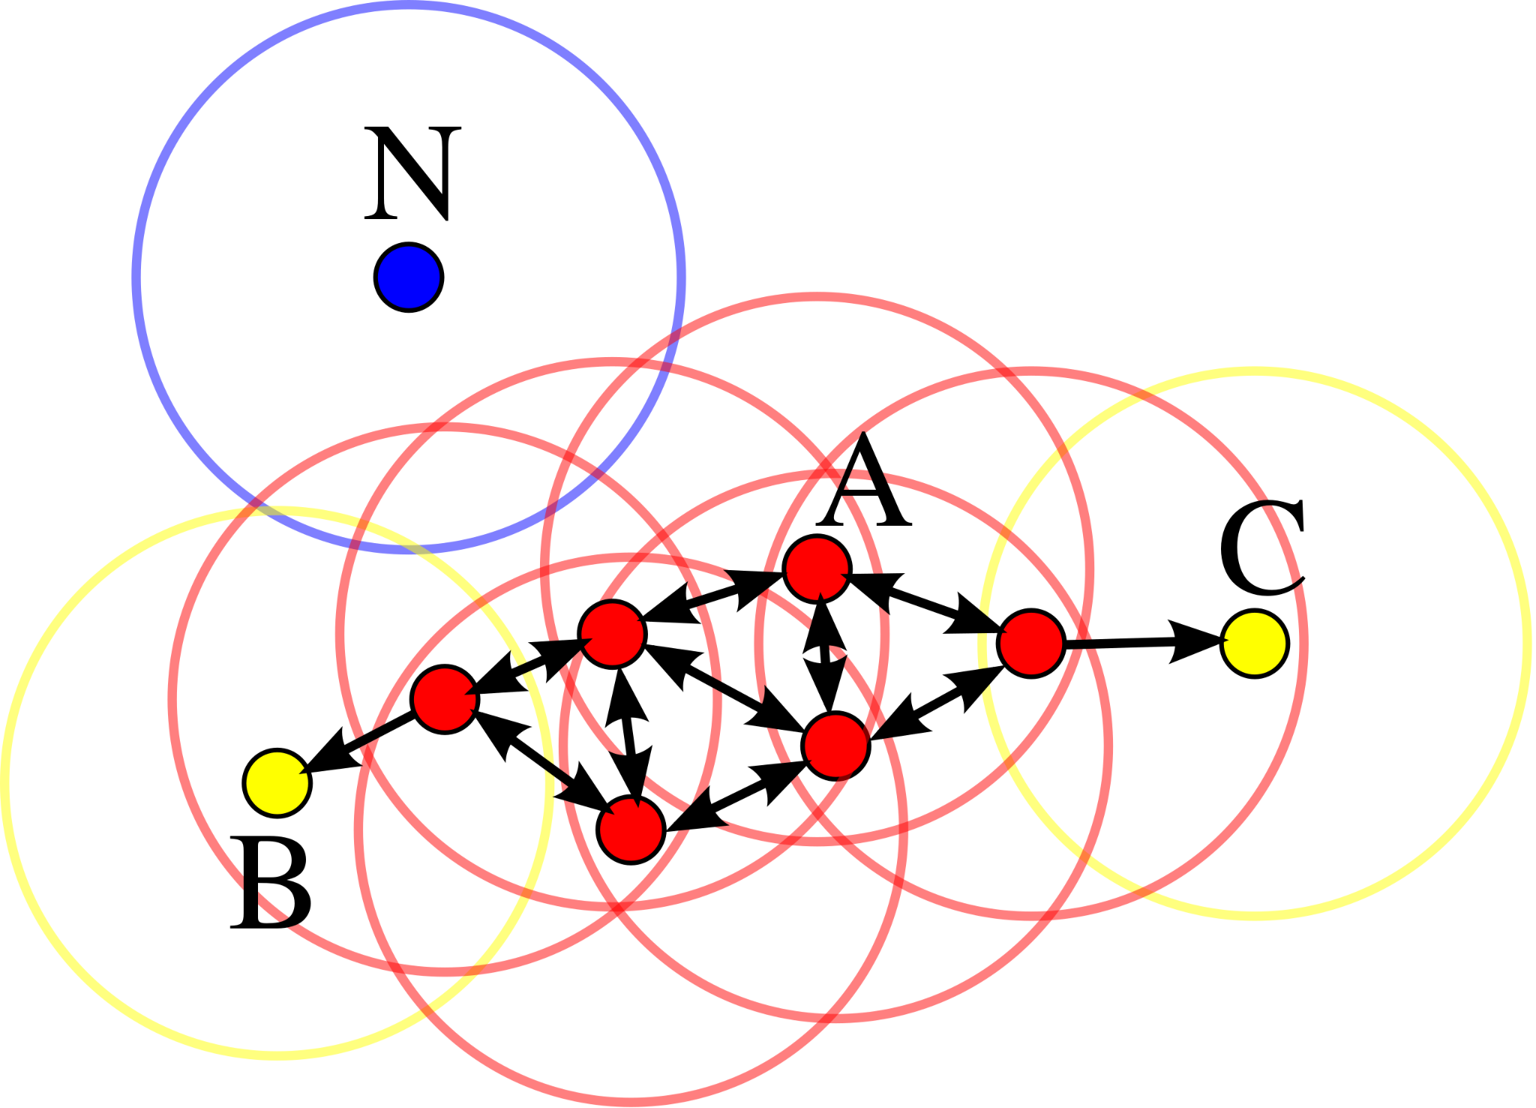
Point cloud: outlier removal
DBSCAN
eps: specifies how close points should be to each other to be considered a part of a cluster.
minPoints: the minimum number of points to form a dense region.

Slide 24
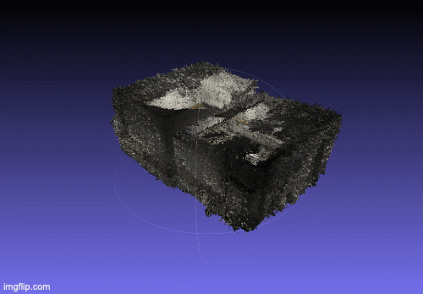
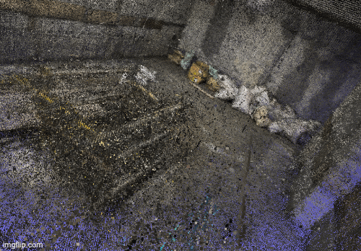
Point cloud: outlier removal
Parameter: eps=30cm, min_points=200

Slide 25
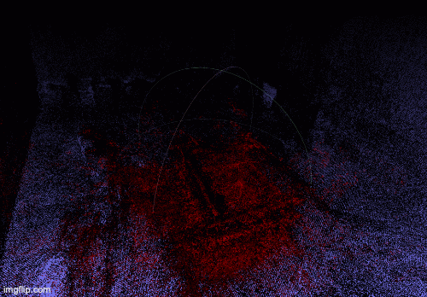
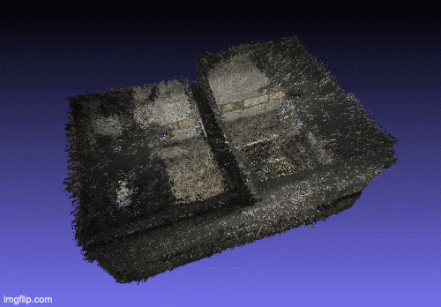
Point Cloud: Semantic segmentation
Depthmap + Semantic Segmentation Mask

Slide 26
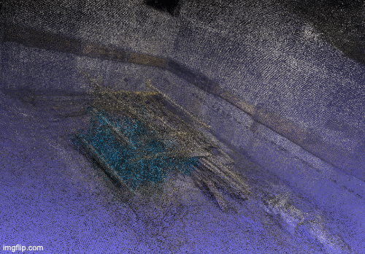
Point Cloud: extract danger zone
DBSCAN
eps=0.2
minpoints=100

Slide 27
Conclusion and Contribution

Slide 28
References
Structure From Motion: https://opensfm.org/docs/using.html, https://www.researchgate.net/publication/303824023_Exploring_the_use_of_3D_GIS_as_an_analytical_tool_in_archaeological_excavation_practice
Down Sample: http://www.open3d.org/docs/release/tutorial/geometry/pointcloud.html
DBSCAN: https://zh.wikipedia.org/wiki/DBSCAN, https://towardsdatascience.com/how-dbscan-works-and-why-should-i-use-it-443b4a191c80
Hyunsoo Kim, Hyun-Soo Lee, Moonseo Park, BooYoung Chung, Sungjoo Hwang.2016.Automated hazardous area identification using laborers' actual and optimal routes,Automation in Construction,Volume 65,2016,Pages 21-32,ISSN 0926-5805.
ILO.2015.Construction: a hazardous work. https://www.ilo.org/global/topics/safety-and-health-at-work/areasofwork/hazardous-work/WCMS_356576/lang--en/index.htm
ISO.2009.ISO 31000:2009(en)Risk management -Principles and Guidelines.https://www.isa.org.jm/files/files/documents/asnzs_31000_2009.pdf
Jovanović, J.M., Aranđelović, M., & Jovanović, M. 2004. Multidisciplinar aspects of occupational accidents and injuries.
Labour Department.2021.Summary of Occupational Safety and Health Statistics. https://www.labour.gov.hk/common/osh/pdf/archive/statistics/OSH_Statistics_2020_tc.pdf
OSHA.2021.https://www.osha.gov.tw/media/7188732/109勞動檢查統計年報-全一冊.pdf
Othman, Idris & Majid, Rafe & Mohamad, Hisham & Shafiq, Nasir & Napiah, Madzlan. 2018. Variety of Accident Causes in Construction Industry. MATEC Web of Conferences. 203. 02006. 10.1051/matecconf/201820302006.
Xu, S., Wang, J., Shou, W. et al. 2021.Computer Vision Techniques in Construction: A Critical Review. Arch Computat Methods Eng 28, 3383–3397

